Slide 2
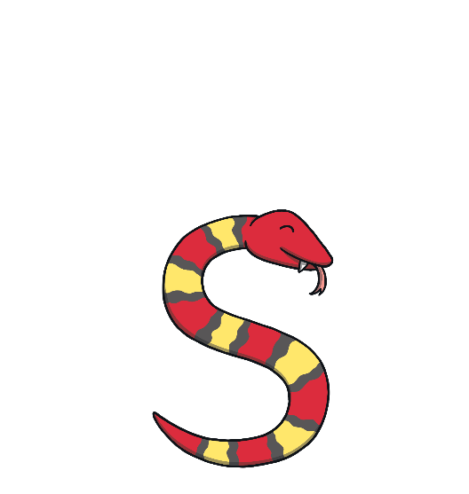
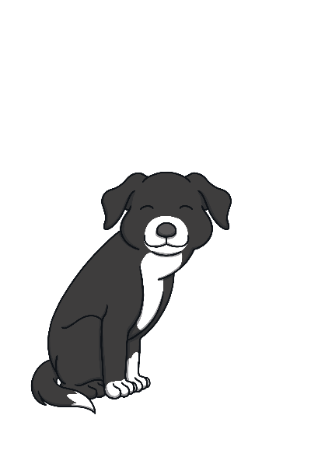
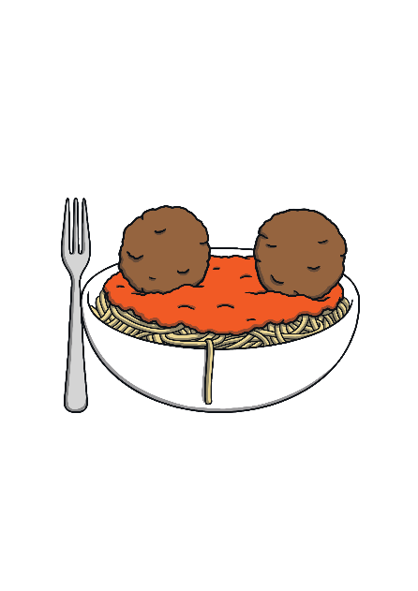
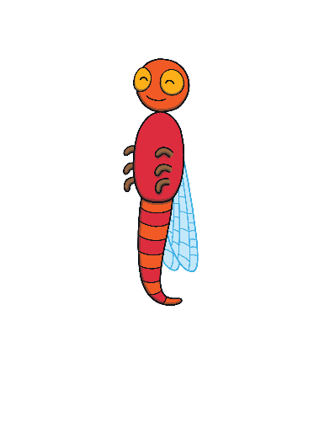
Revisit and Review
Let’s practise Sam’s Sounds!
p
a
s
t
n
m
i

Slide 3
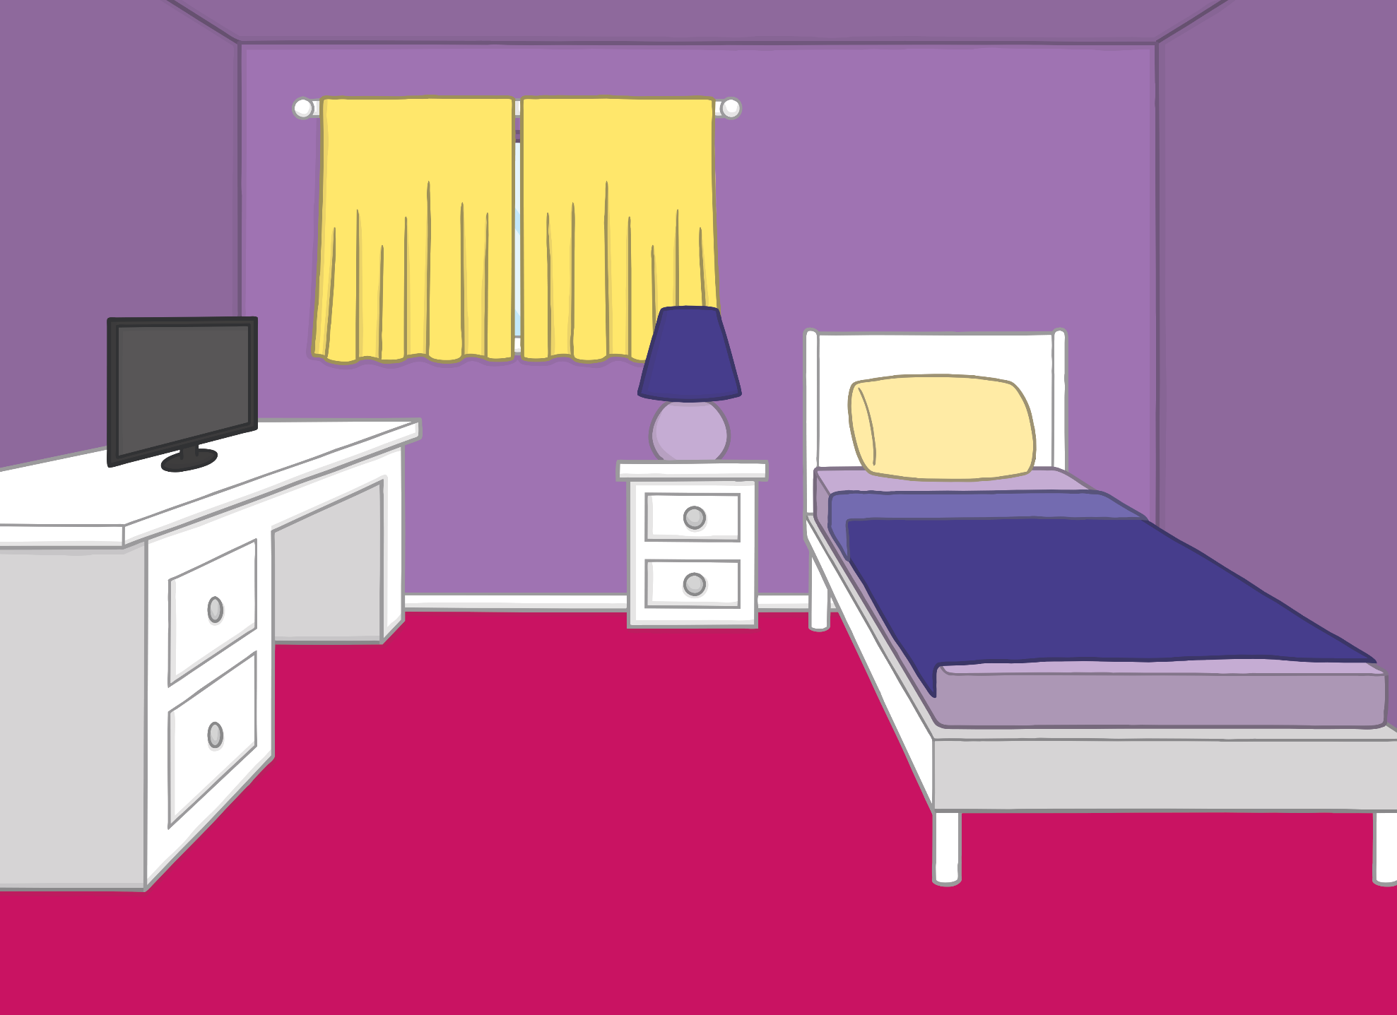
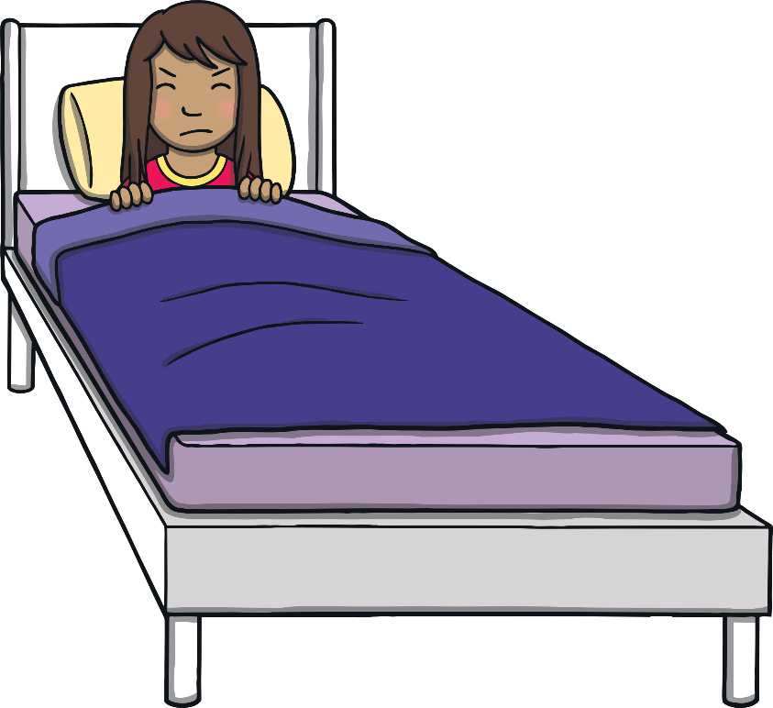
‘Teaching’ Activity
Teach
It was Sunday morning and Sam was woken up by a very loud noise!

Slide 4
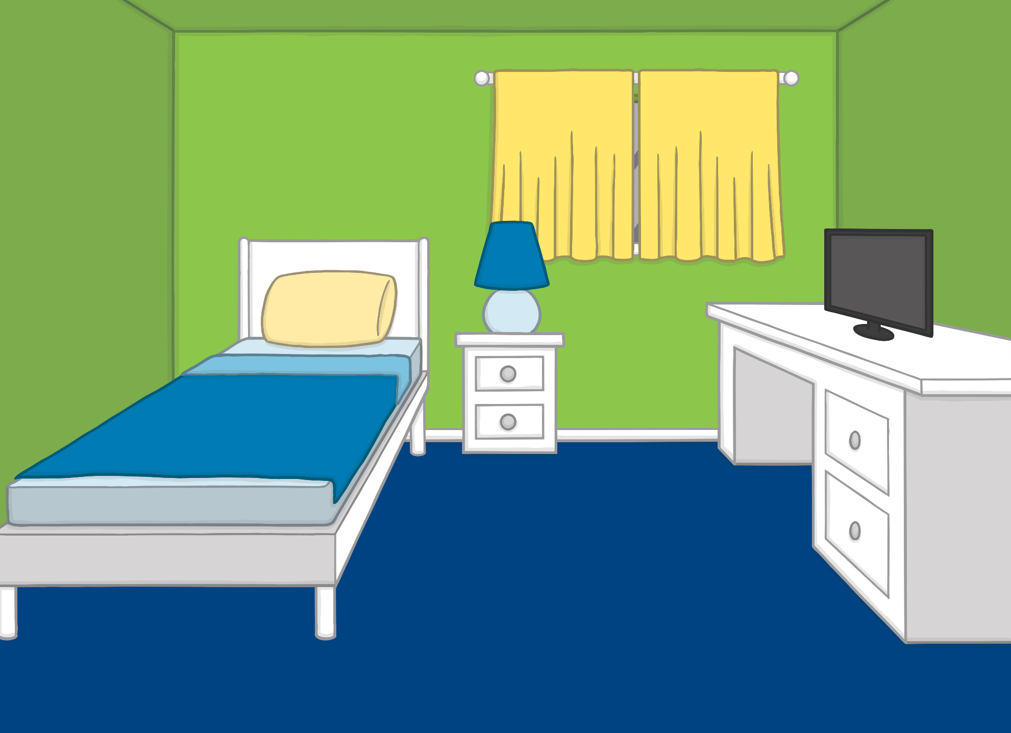
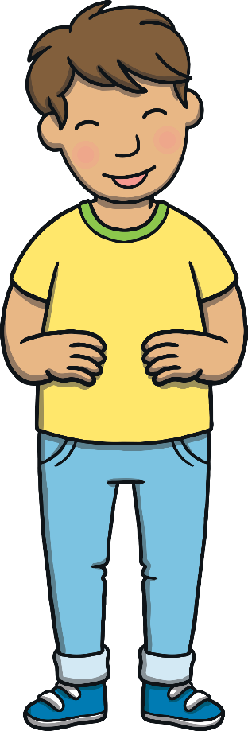
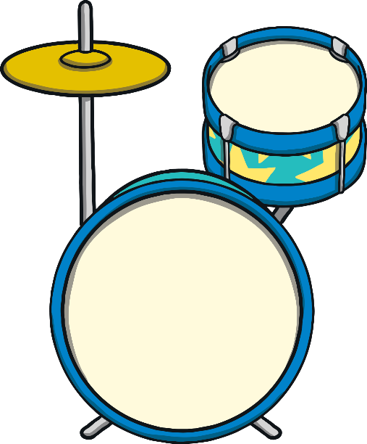
‘Teaching’ Activity
Teach
Sam went into Kit’s room. He was playing his drum kit. “Listen, Sam,” Kit said. “I’ve learnt a new rhythm!”

Slide 5
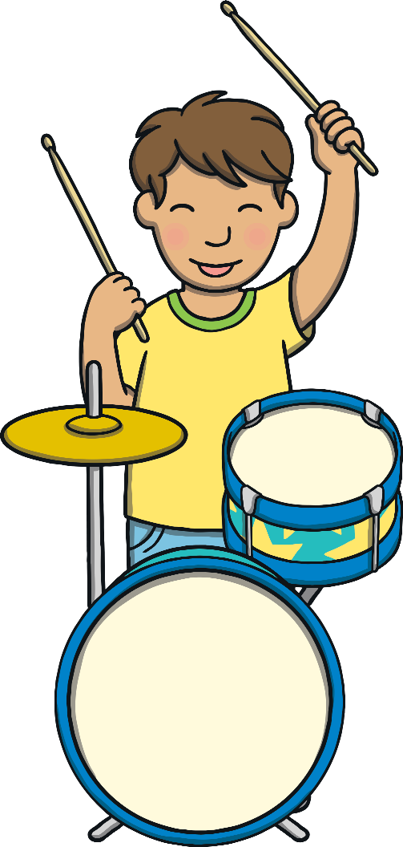
Teach
“Your drumming is so loud!” said Sam, covering her ears. “I know!” laughed Kit and he banged the drum again. “Drum, drum, d, d, d!”

Slide 6
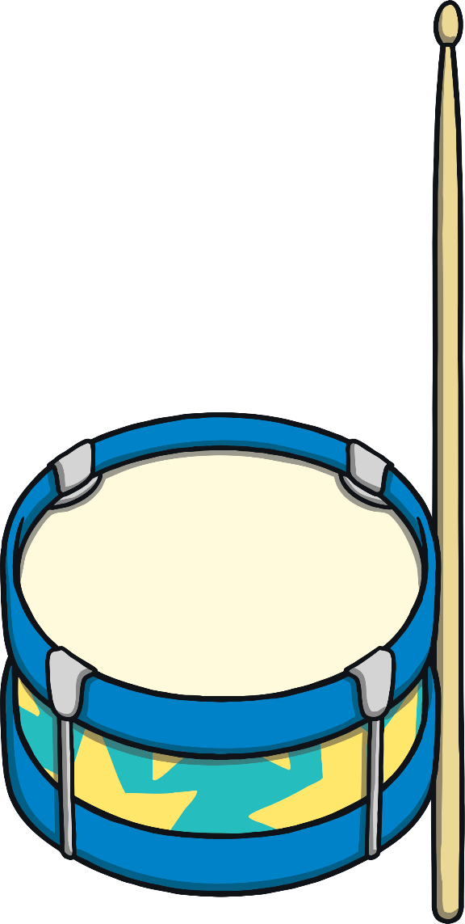
d
Teach

Slide 7
Teach
d

Slide 8
Action
Teach
Play your drumkit!
Say ‘d, d, d’.

Slide 9
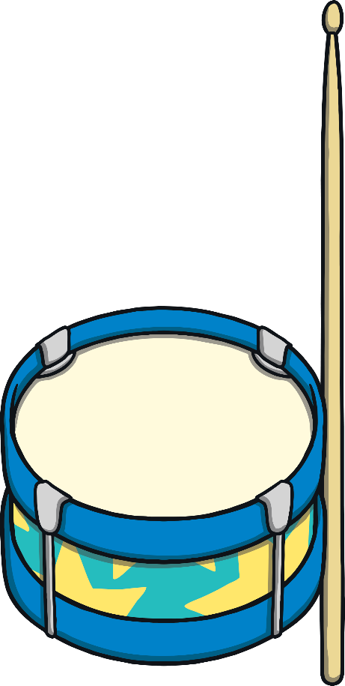
Write the Letter
Teach
d
Around the drum, up and down the stick.
Play

Slide 10
Let’s Sing!
Teach
(To the tune of ‘Head, Shoulders, Knees and Toes’)
We like to bang our drums, d - d - d
We like to bang our drums, d - d - d
With tunes in our heads and sticks in our hands,
We like to bang our drums, d - d - d!
Play Song

Slide 11
Phoneme Beat
Teach
Play your drum! Look at the picture and bang your drum for each sound in the word.
X
Drumming as they segment words will encourage children to hear each phoneme separately.
Click me for Kit’s teaching tips!

Slide 12
Practise

Slide 13
Practise

Slide 14
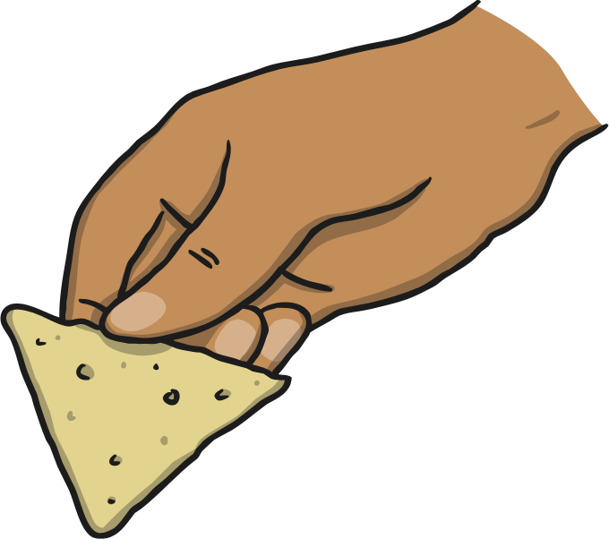
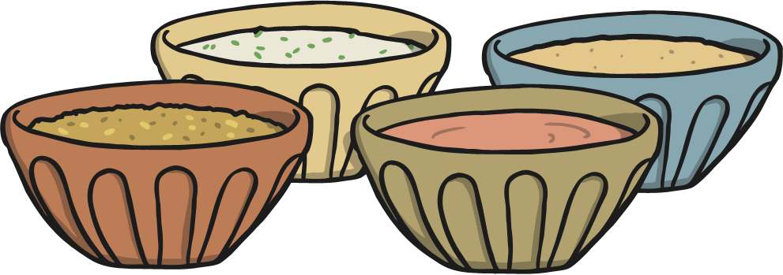
Practise

Slide 15
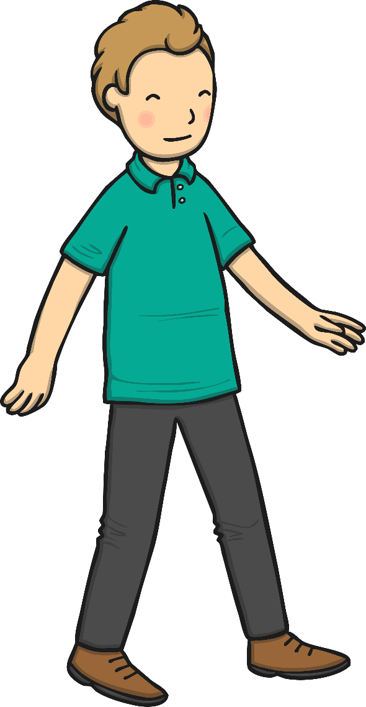
Practise

Slide 16
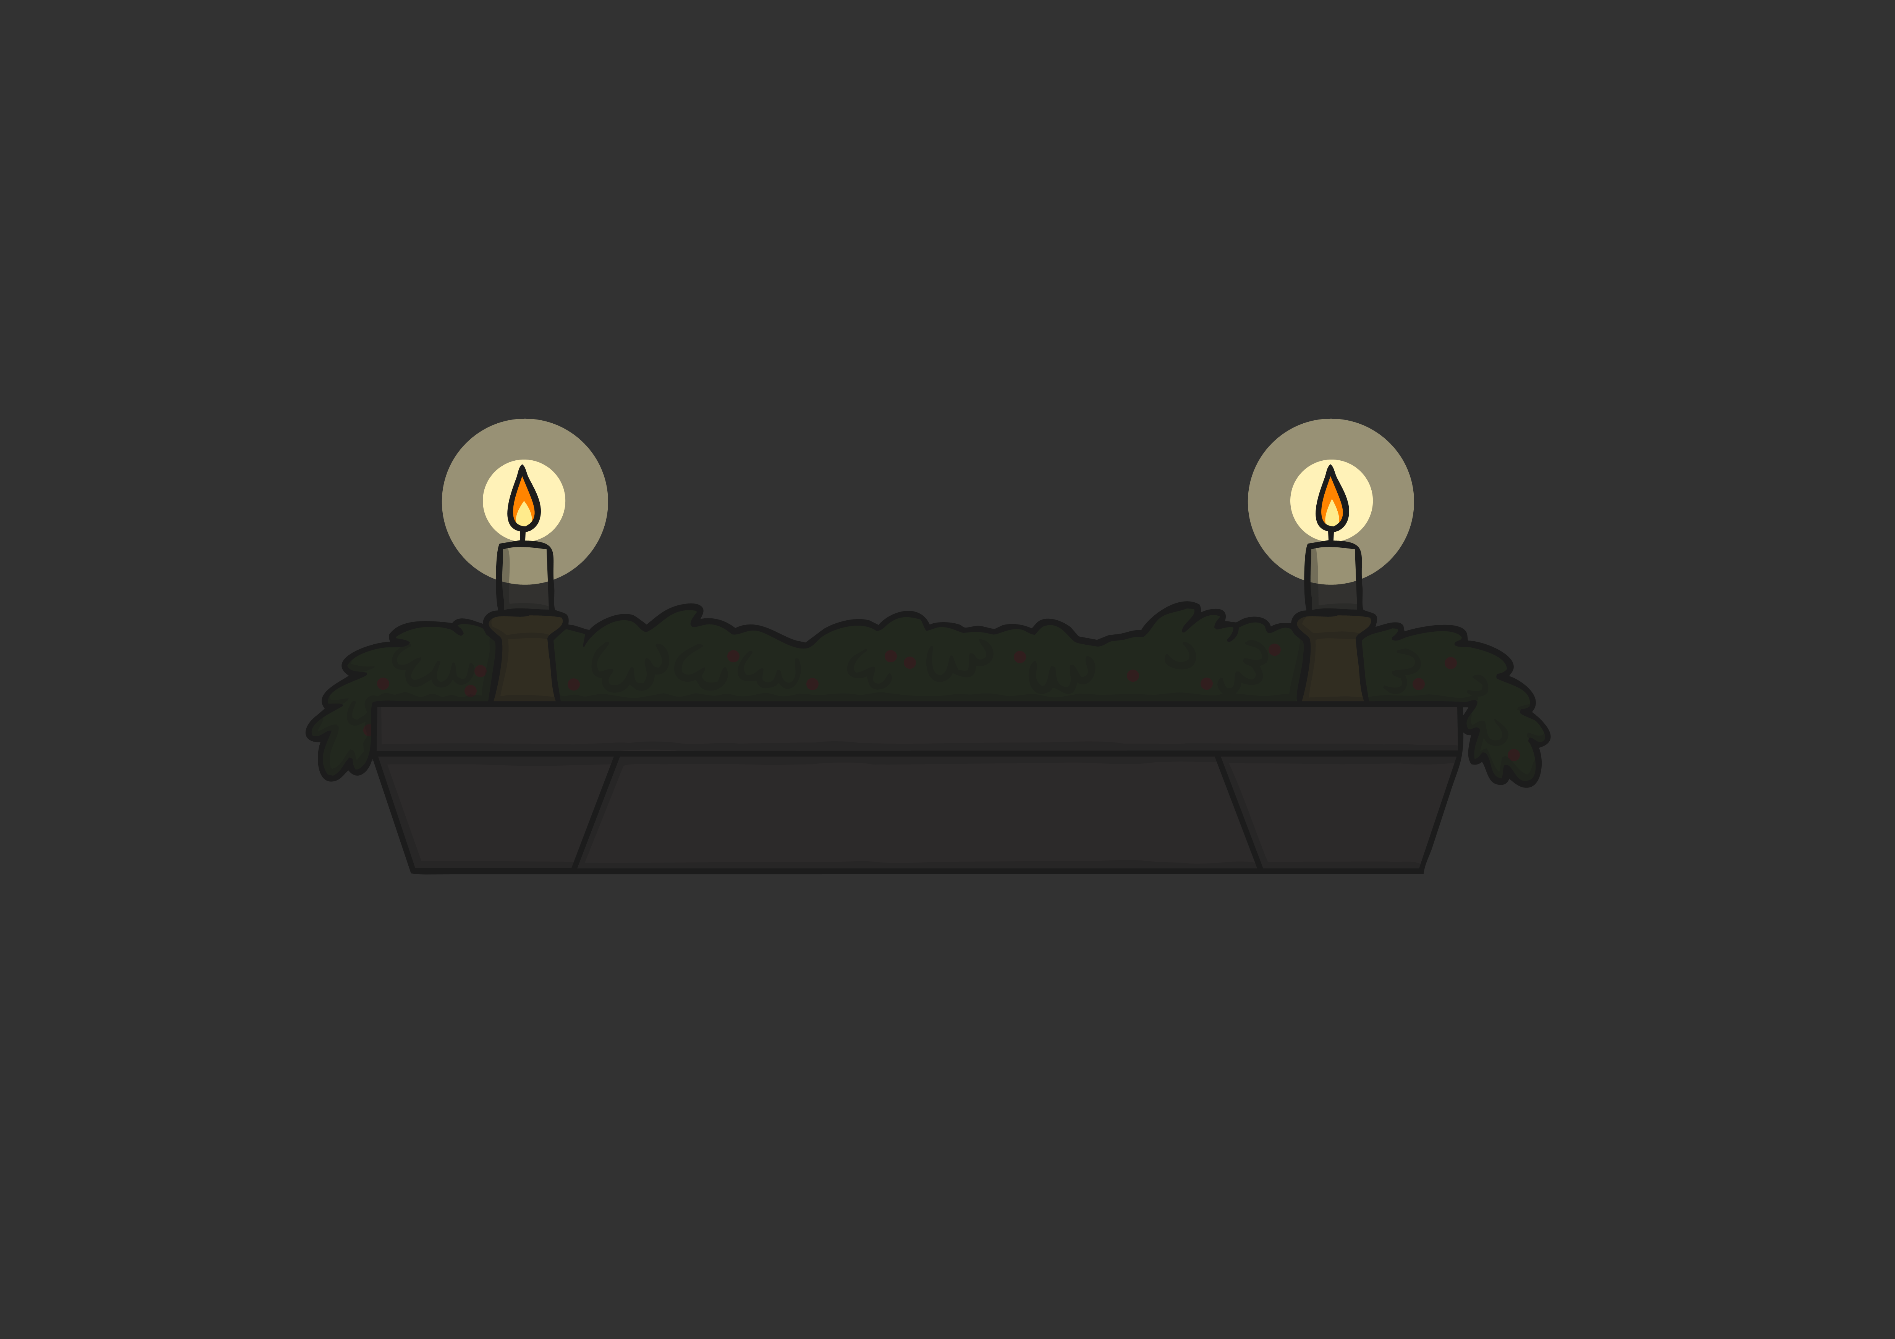
Practise

Slide 17
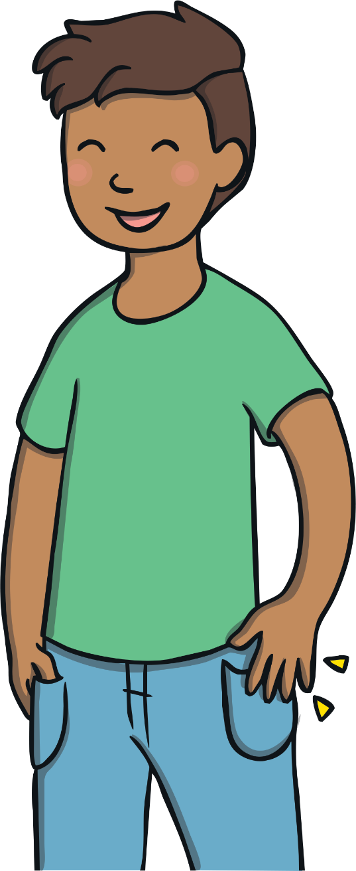
Practise

Slide 18
Apply
“Can I have a go?” asked Sam. Kit passed her the drumsticks and Sam banged a drum.
“You’re right,” she said. “This is pretty fun!”

Slide 19
Music Fans
Apply
Look at the picture. Click on the phoneme fan to choose the right letters to make up the word.
X
You may wish to give phoneme fans to the children for this activity.
Click me for Kit’s teaching tips!

Slide 20
Apply
s
t
i
m
a
p
n
d

Slide 21
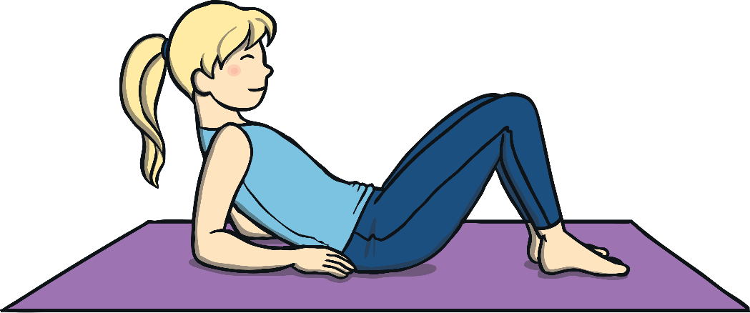
Apply
s
t
i
m
a
p
n
d

Slide 22
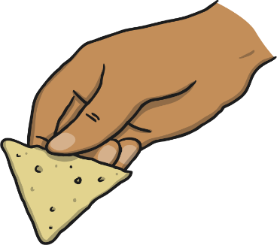
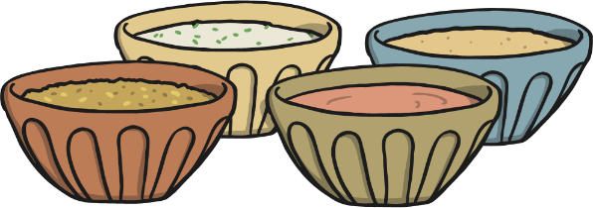
Apply
s
t
i
m
a
p
n
d

Slide 23
Apply
s
t
i
m
a
p
n
d

Slide 24
Apply
s
t
i
m
a
p
n
d

Slide 25
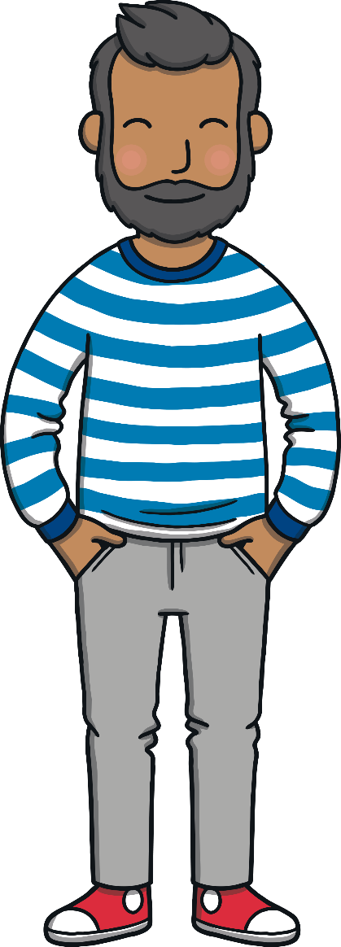
Apply
Mum and Dad came into the room. “It’s a bit early for that, children,” said Mum, sleepily.
“No it’s not!” laughed Kit and Sam.

Slide 26
Today, we have learnt…
Apply
d

