Slide 2
Diving into Mastery Guidance for Educators
Each activity sheet is split into three sections, diving, deeper and deepest, which are represented by the following icons:
These carefully designed activities take your children through a learning journey, initially ensuring they are fluent with the key concept being taught; then applying this to a range of reasoning and problem-solving activities.
These sheets might not necessarily be used in a linear way. Some children might begin at the ‘Deeper’ section and in fact, others may ‘dive straight in’ to the ‘Deepest’ section if they have already mastered the skill and are applying this to show their depth of understanding.
Diving
Deeper
Deepest

Slide 3
Aim
Convert between different units of measure.

Slide 4
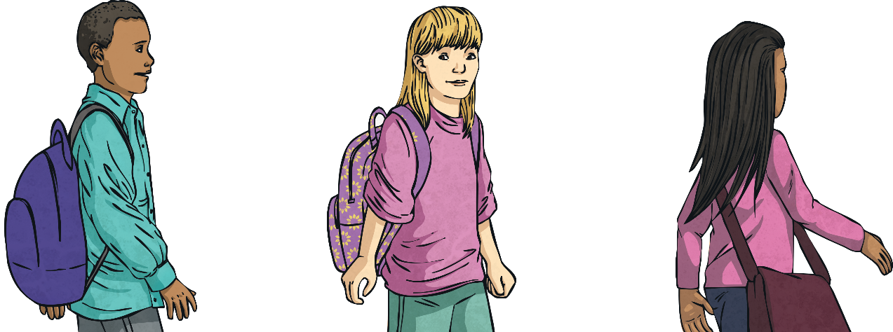
Kilometres
Diving
Complete the table to show how far each child walked during Fitness Friday.
 | Distance in Metres | Distance in Kilometres
Arlo | 3000
Bryony | 4700
Chen | 1750
Daniel |  | 6
Eesa |  | 2.5
Frankie |  | 1.08
3
4.7
1.75 or 1¾
6000
2500
1080

Slide 5
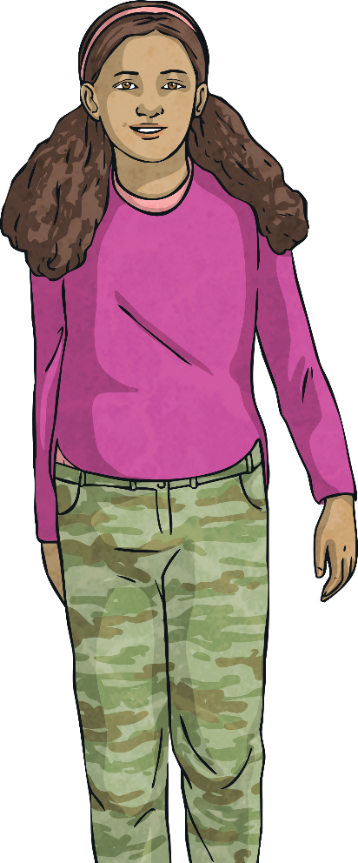
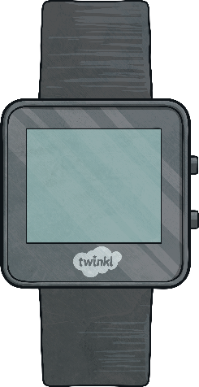
Kilometres
Diving
Grace’s fitness watch shows that she has walked 3600m today.
How much further does she need to walk to reach 5km?
5km
3600m | ?
5km = 5000m 5000m – 3600m = 1400m 1400m = 1.4km
Grace needs to walk 1400m, or 1.4km, further to reach 5km.
1.4km until 5km

Slide 6
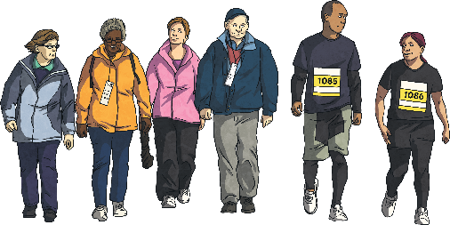
Kilometres
Deeper
Work out whether each statement below is true or false and explain how you know.
 | Distance Walked
Arlo | 3200m
Bryony | 3.7km
Chen | ½km
Daniel | 2.8km
Eesa | 3070m
Bryony and Eesa walked the same distance.
False. 3070m is 3.07km, which is less than 3.7km.
Chen walked 800m.
False. Chen walked half a kilometre, which is 500m.
Arlo and Daniel walked 6km in total.
True. Daniel walked 2800m. 3200m + 2800m = 6000m, which is 6km.

Slide 7
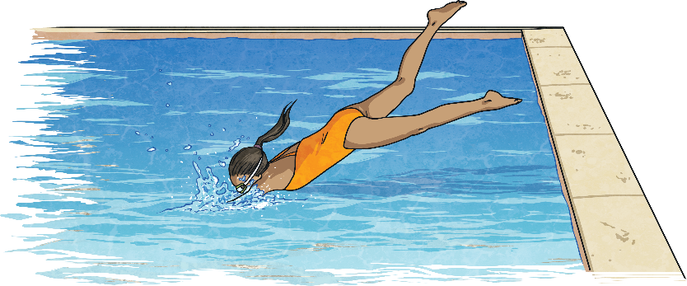
Kilometres
Deepest
Use the clues below to find out how far each child swam at the school swimathon.
Explain how you worked out each answer.
 | Distance in Kilometres
Arlo
Bryony
Chen
Daniel
½km or 0.5km
1.5km
2.7km
2.2km
Arlo + Bryony = 2000m
Arlo swam a quarter of this distance.
Bryony + Chen = 4200m
Chen - Arlo = Daniel

Slide 8
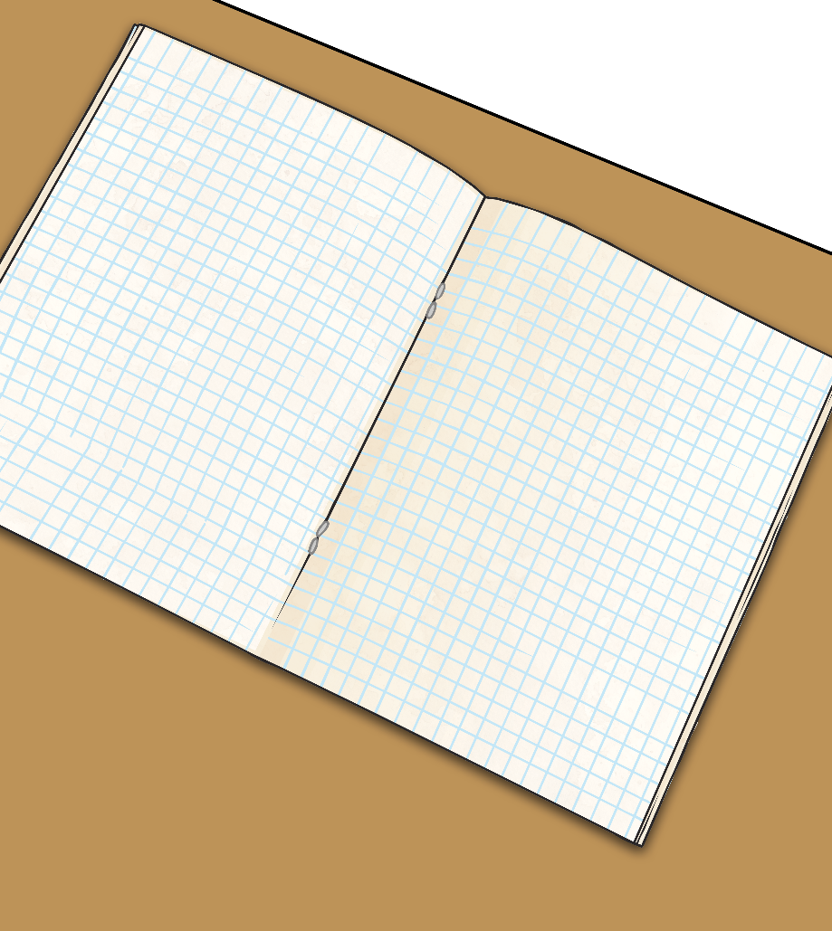
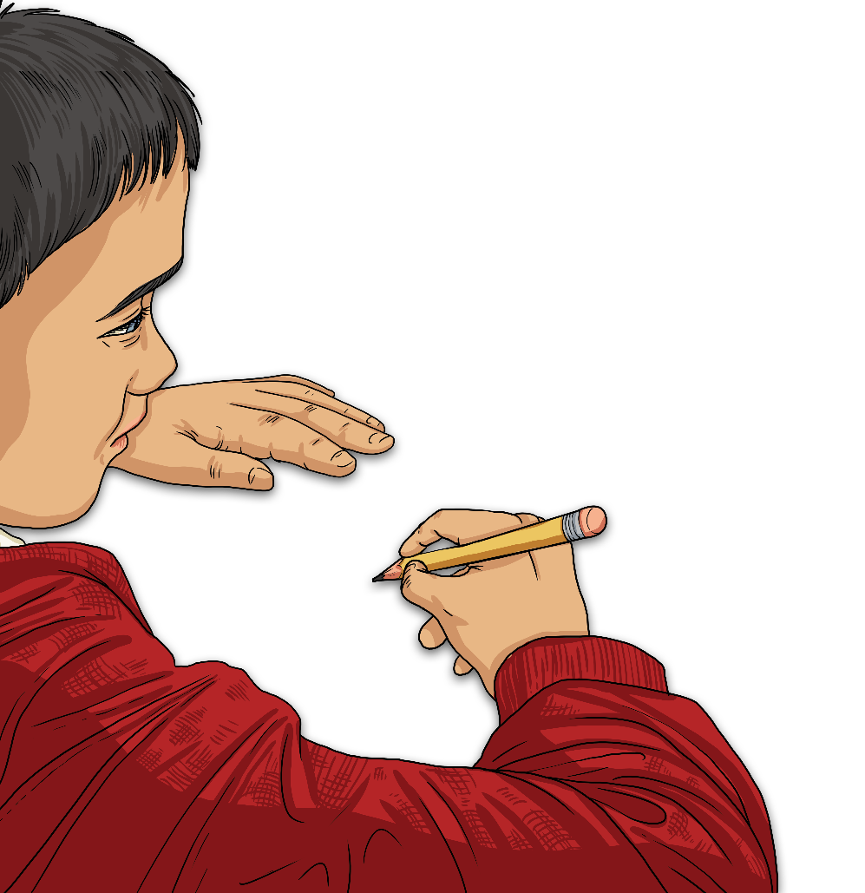
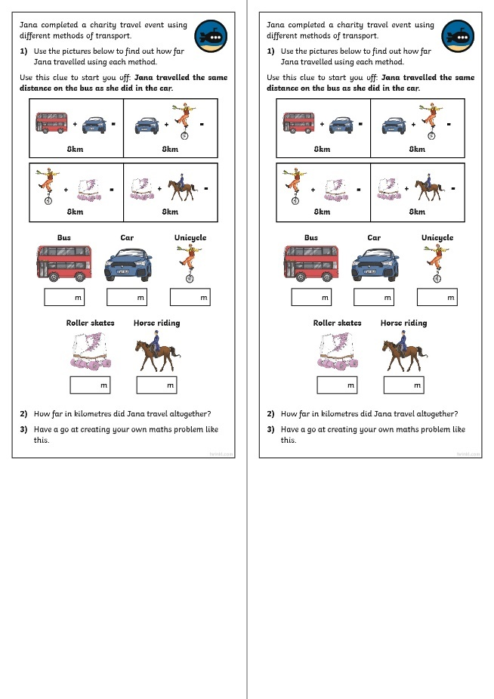
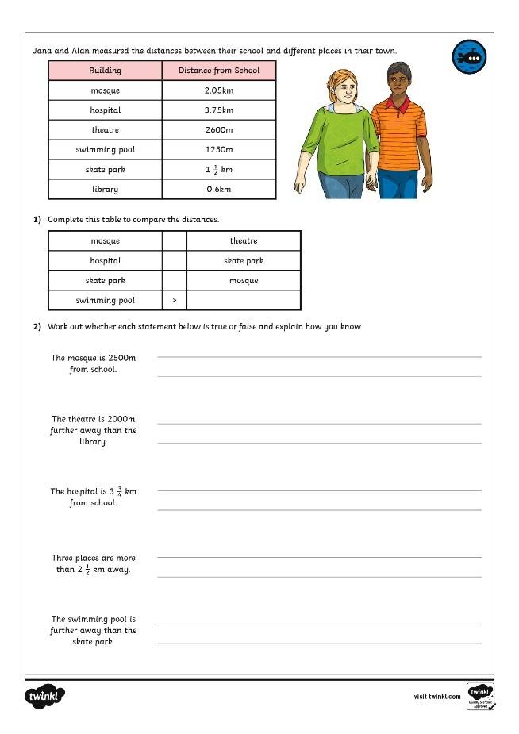
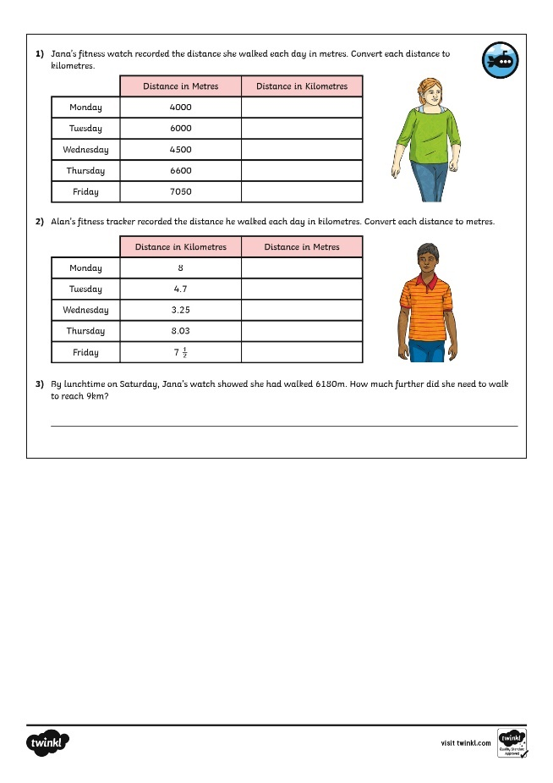
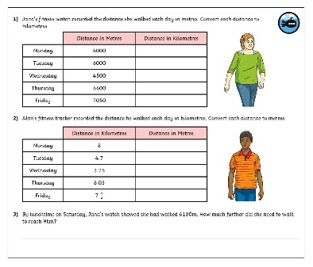
Kilometres
Dive in by completing your own activity!

Slide 9
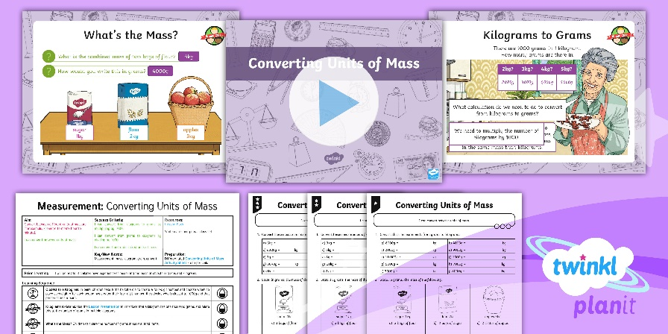
Need Planning to Complement this Resource?
National Curriculum Aim
Convert between different units of measure.
For more planning resources to support this aim, click here.
Twinkl PlanIt is our award-winning scheme of work with over 4000 resources.

