Slide 1


Year 6 Curriculum Meeting
Mrs Baldwin
Mrs Rudd
Miss Clarke

Slide 2
Itinerary
Welcome and introduction
Curriculum overview
Behaviour expectations
Homework expectations
PE days
School Trips
Prayer & Liturgy
Prayer Book
Questions

Slide 3
Curriculum
Children will be undertaking Maths, Writing and Reading lessons in the morning.
In the afternoon children will carry out RE and foundation subjects such as Science, History and Computing.
RE takes place for 2 and a half hours each week. One of these sessions will be RSE.
Art or D&T will be taught weekly.

Slide 4
Expectations
All children have a responsibility to live out our Mission Statement:
‘We come to school to live and learn happily together by loving ourselves and each other as Jesus teaches us’
Children are expected to follow our school rules as well as class rules. Class rules have been created with the help of the children.
Children are also expected to follow the school’s Golden Rule:
‘Treat others as you wish to be treated’.
Children should be dressed smartly in school uniform: No trainers and only a small bow in the hair.

Slide 5
SATS week
Year 6 SATs week will take place on the week beginning Monday 11th May.
Please ensure your child attends school everyday (unless ill) so that they do not miss vital learning.
At the end of each half term, we will send home the children's papers so that you can see what is going well and what could be improved.

Slide 6
Homework
Homework will be set on Atom Prime on a Friday. This will run up to Christmas.
Homework will then be set from SATs Practice CGP books.
Each week Spellings, Maths and English tasks will be set.
Times Table Rock Stars should be practised weekly even if it is just for 5 minutes
The children should read at home daily and the home-school book should be signed.

Slide 7
PE
P.E. takes place twice a week on a Tuesday and Friday. On Tuesday the PE session will be led by a Sports Coach.

Slide 8
Snacks, water and lunch
A healthy snack can be brought for break times.
Children should bring drinking bottles with a sport spout to school with them each day.
Children are eating their lunch in the dining hall. Packed lunches are eating outside when the weather is nice. If they choose to bring a Packed Lunch it should be nutritious.

Slide 9
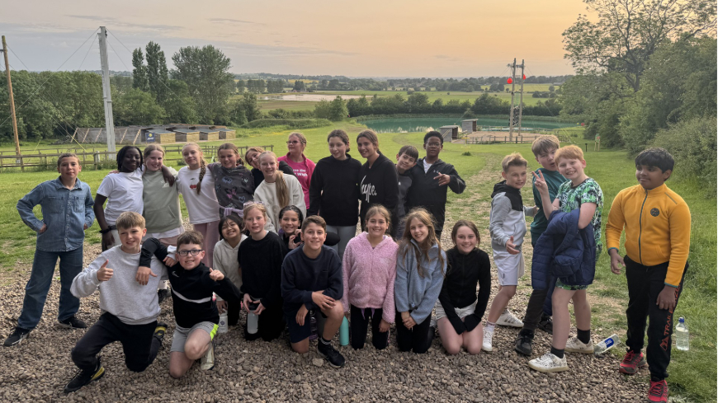
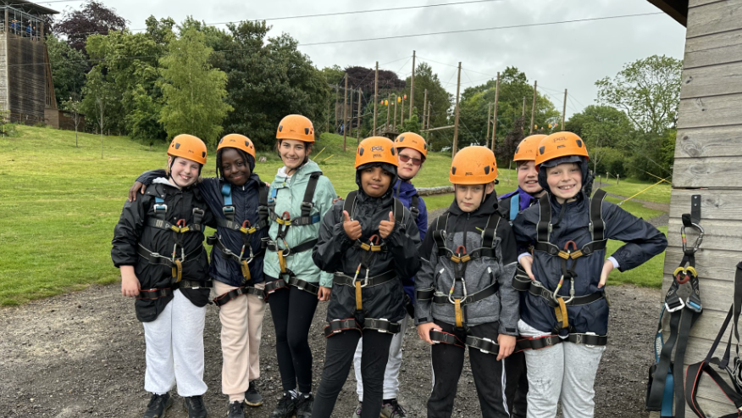
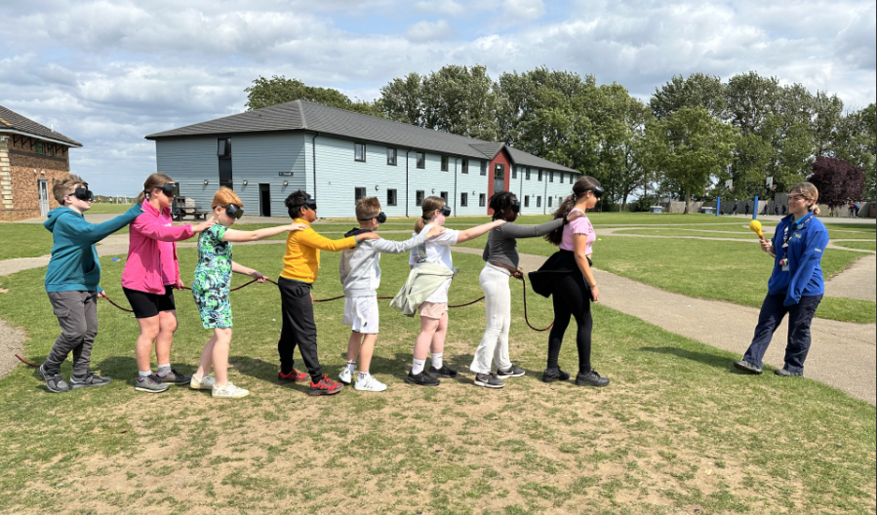
School Trips
This Year children will be going to PGL for a residential trip. Payments for this have been set up on school gateway.

Slide 10
Prayer & Liturgy
Prayer and Liturgy is now to be led by myself each Wednesday morning. We will read the relevant Gospel from the Bible and the children will be able to express their understanding of it. Noting any answer they provide will not be addressed as right or wrong as it will be their own personal understanding. They will instead be thanked for sharing their contribution.
In the last week of every half term, a group of children will present the session to the whole class.

Slide 11
Prayer Book
We now have a class Prayer Book. This will be sent home with a different child every night. The child will be expected to write a short prayer. They are to return to school with the Prayer Book the next day and they will have the opportunity to read the Prayer to the rest of the class.
Thank you for your support in ensuring this happens.

Slide 12
THANK YOU

