Slide 1

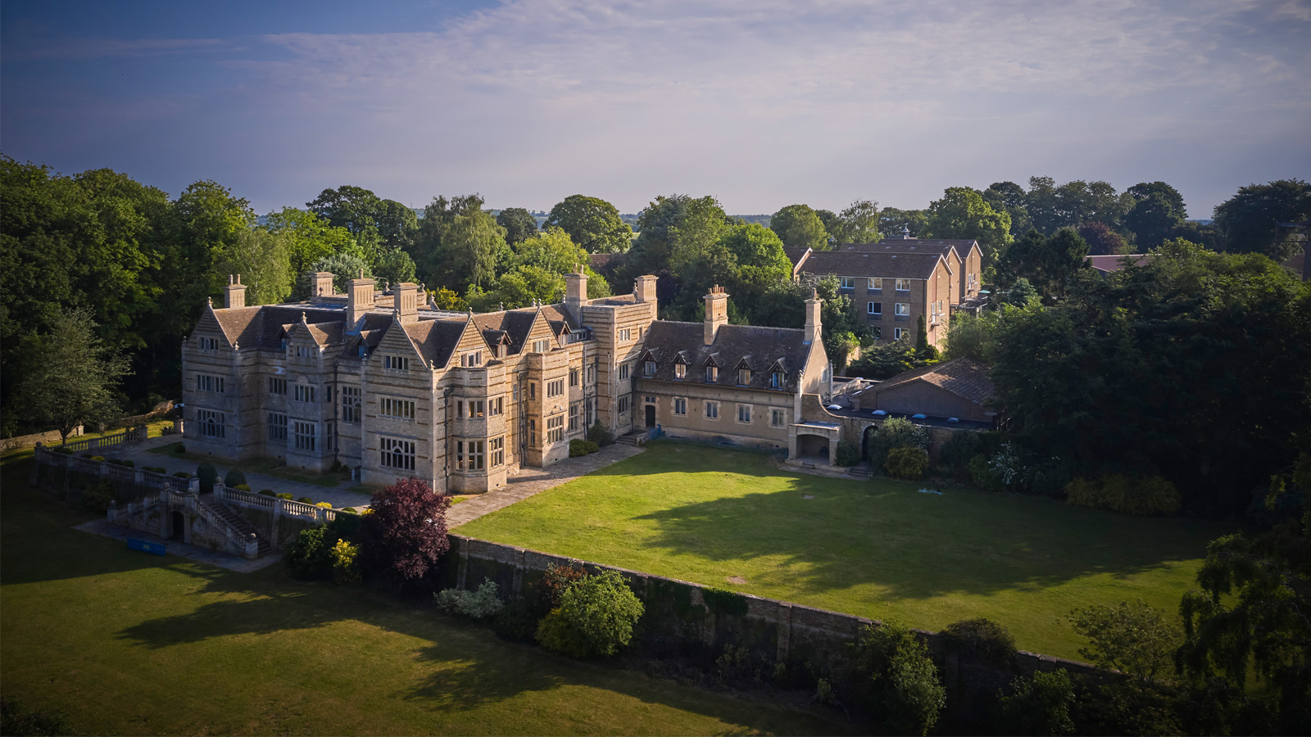
PGL - lINCOLN

Slide 2
PGL - lINCOLN
Accompanying Adults:
Mrs Baldwin
Mrs Turner

Slide 3
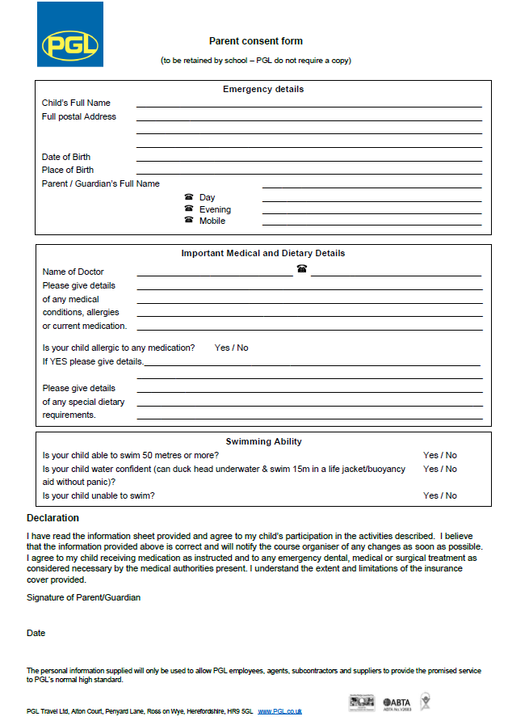
Please complete and give to Mrs Baldwin by Friday 22nd May
Please also complete the medication form and hand in with the medication by Friday.

Slide 4
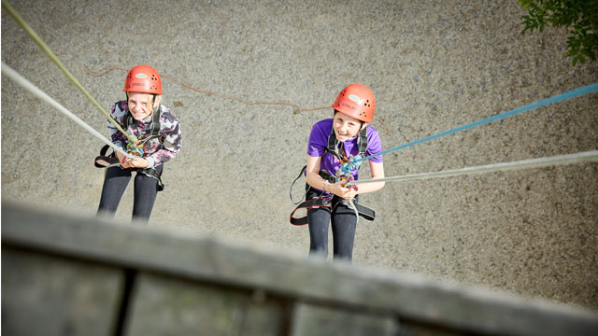
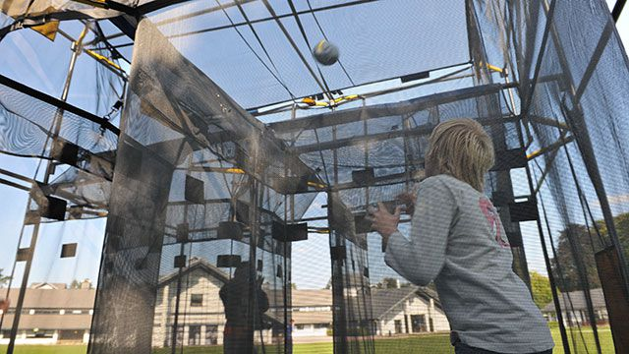
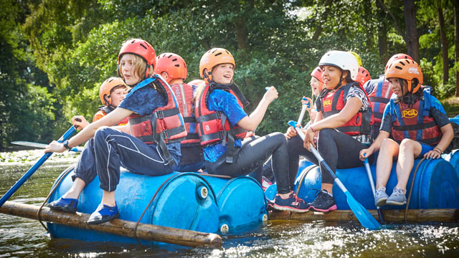
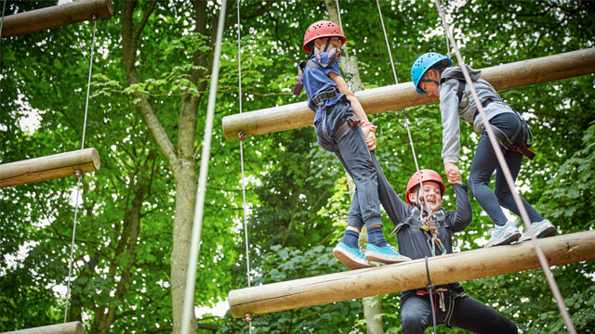
PGL
Develops:
-friendship bonds
-perseverance
-resilience
-empathy
-teamwork
Personal growth:
- ‘Challenge by choice’

Slide 5
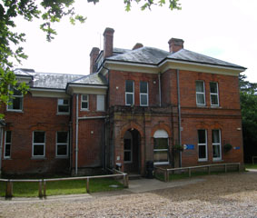
Sunday 31st May 2026
Meet at Elsie House
Please give all money (in a named wallet/container) to Mrs Baldwin for safe-keeping
Bring a bag with:
- a packed lunch
-bottles of water
-Departure time: 12.30pm

Slide 6
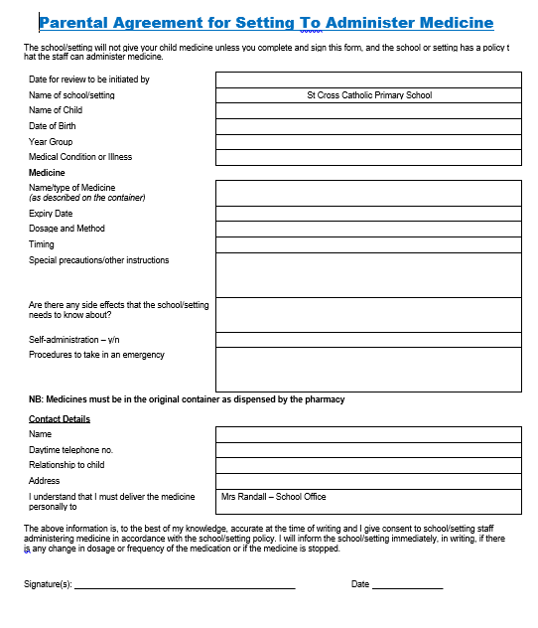
Please ensure that all medication is accompanied by this form.
All medication must be in a clear, sealed bag and labelled.
We cannot take any medication held in school, so all it must be brought from home.

Slide 7
Wednesday 3rd June 2026
Departure time 2pm
Arrival time back at school: 5pm (traffic dependent!)
Please keep a look-out for updates via the school website!
Thursday 4th June 2026 – Day Off for all children who went to PGL.

Slide 8
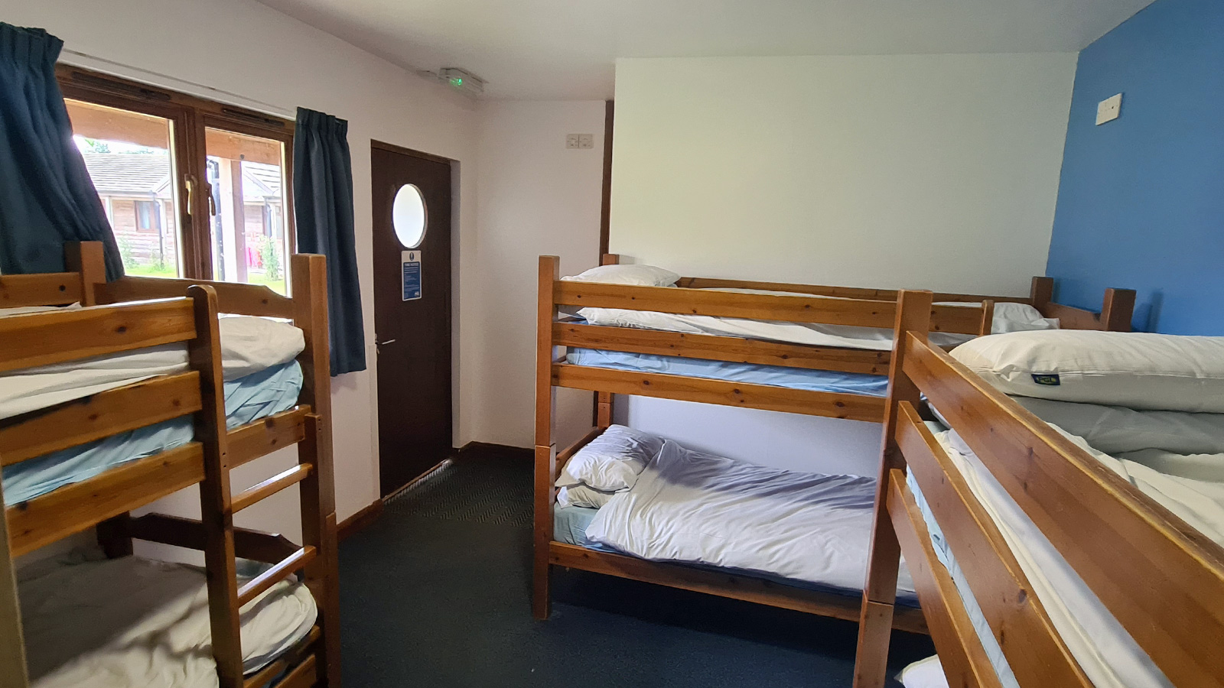
Named clothes, including:
-T-shirts (No crop/strappy tops please!)
-Long sleeved shirt/T-shirts
-Waterproof jacket
-Fleeces/jumpers
-Long bottoms: leggings, jogging bottoms, etc
2 Pairs of trainers
Suitable nightwear
Water bottle
Waterproof jacket
2 towels (one clean, one ‘dirty’)
Plenty of socks
Sun cream and a cap
Hairbands
Plastic binbags for wet and dirty clothing
No aerosol cans/sprays
Please see Kit List for full details.
Please note: all bedding (pillows, duvet/pillow covers etc) will be provided by PGL

Slide 9
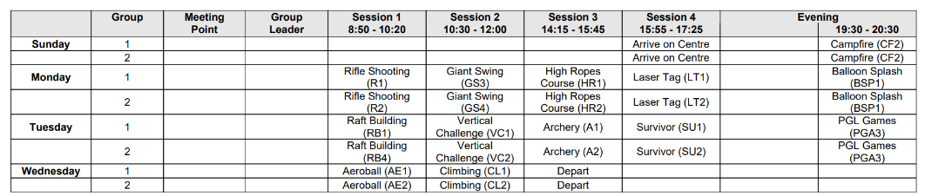
Provisional Programme of Activities

Slide 10
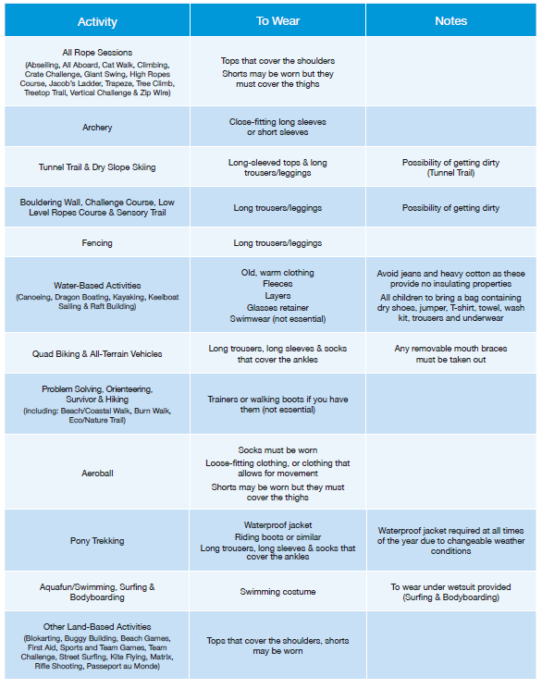

Slide 11
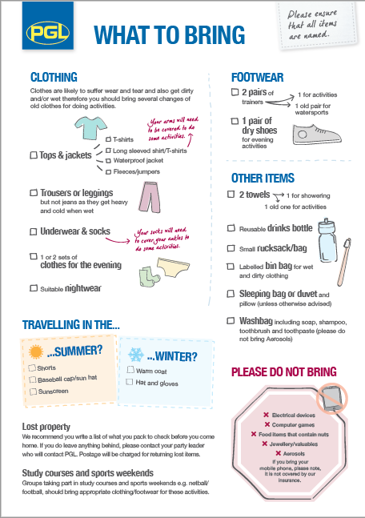
Please note: all bedding (pillows, duvet/pillow covers etc) will be provided by PGL

Slide 12
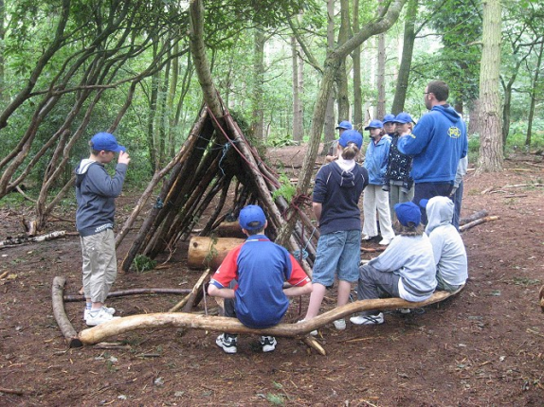
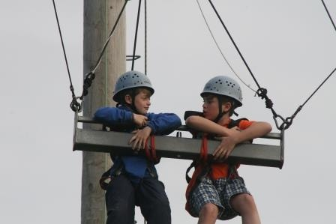
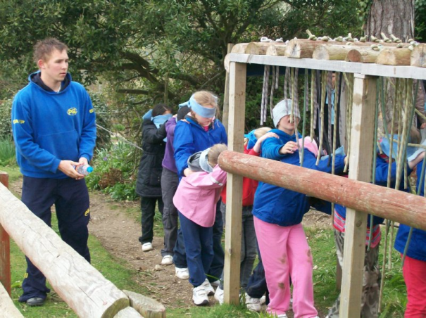
SAMPLE DAY:
7.00 Wake up
8.00 Breakfast
9.15-10.45 Activity Session 1
10.55- 12.25 Activity Session 2
12.25 Lunch
14:20 -15.50 Activity Session 3
16:00- 17.30 Activity Session 4
17.30 Dinner
19.00-20:30 Evening Activity
9:30pm Lights out!

Slide 13
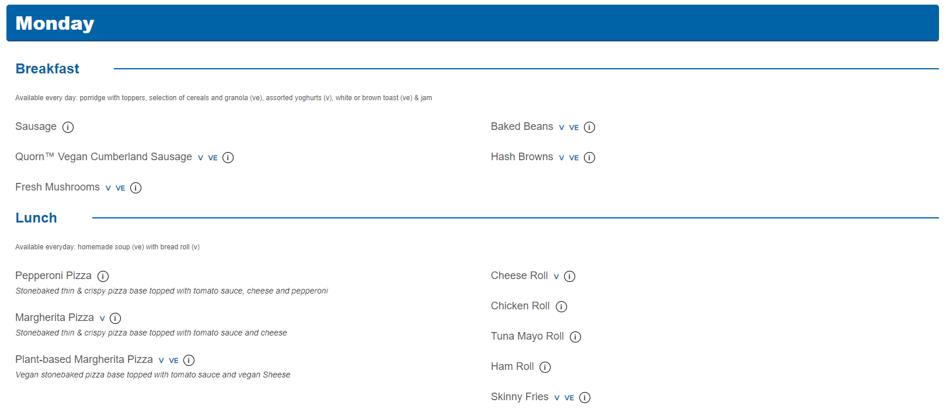
Menu
https://www.pgl.co.uk/en-gb/school-trips/menus-and-food

Slide 14
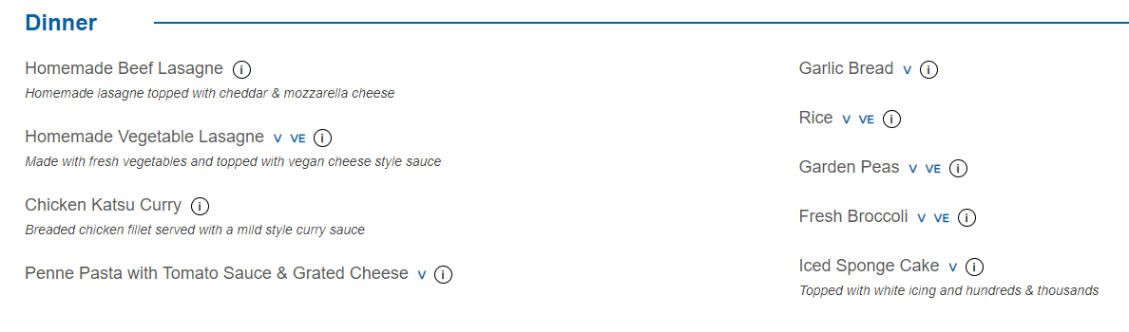
Menu
https://www.pgl.co.uk/en-gb/school-trips/menus-and-food

Slide 15

PGL - Lincoln
Pocket Money – £15 (maximum) in change
Playing cards/books
No mobile phones, electronic games or iPads.
No fizzy drinks

Slide 16
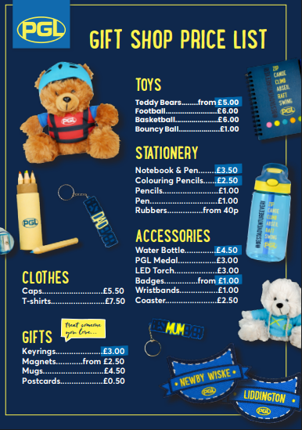

Slide 17
There will be daily updates via the school website - keep a look out!

