Slide 1
Early Years
Induction Meeting

Slide 2
Welcome to St Augustine’s Catholic Primary School
This presentation aims to provide an introduction to our school and includes initial information which we hope you will find useful. Should you have any further questions, staff will be happy to discuss these with you.
The information in this presentation will also be included in on the school website.
The school website; www.staugustines.herts.sch.uk, is kept up to date with the latest news and events and have lots more information about our school.

Slide 3





Who’s Who in Early Years?
Nursery teacher: Mrs Smitham supported by Mrs Ranasinghe and Mrs Pugsley.
Reception teacher: Mrs Blackwell supported by Mrs Amodeo.

Slide 4
Transition Day 10/07/2025
Nursery: You and your child will have the opportunity to visit their new classroom. We would like you to stay during this visit so that you can informally meet other parents, talk to your child’s teacher and classroom assistant, look around the classroom and outside area in order to help familiarise yourself and your child with the new classroom. An email has already been sent with your time slot.
Reception: Children moving up to Reception from St Augustine’s will start the day as usual in Nursery. Children coming from other settings have received an email. Please come to the side EYFS entrance at 9:30am. Children will be invited in from this door at this time. Pick up is at 11:30am, same entrance.
We are also offering a 10 minute video call on Tuesday 1st July (3-4pm) and Thursday 3rd July (4-5pm). Please sign up.

Slide 5

On Your Child’s First Day in September
Nursery: Thursday 4th and Friday 5th September are half days; 8:40am to 11:30am. 15 children will be invited on the Thursday and 15 on the Friday. This will help settle the children more quickly, in a calm environment. From Monday 8th September, normal sessions will start. Entrance is from the main school gate. Parents walk their children down to EYFS through the main playground and will be greeted by Mrs Smitham. Pick up will be from the EYFS side entrance.
Reception: Reception starts at 8:40am on Thursday 4th September. Children come through the main school gate with their parents and will be greeted by Mrs Blackwell at the EYFS gate. They will be picked up at the gate at 3:10am.

Slide 6

Trays and Pegs/Objects from Home
Trays and Pegs: Children will have a labelled peg for their coat/bag as well as a tray for their work.
Objects from home: We ask that all toys and personal belongings such as bracelets, soft toys, etc. stay at home. This is to prevent upset if things get lost or broken. We teach sharing and turn-taking with our own resources. Dummies are also not to be brought into Nursery for these same reasons and also the impact that they can have on a child’s speech.

Slide 7


Clothing
Clothing: At St Augustine’s, all children wear a school uniform.
In Nursery, this consists of navy joggers or shorts, a white polo t-shirt and a yellow jumper. Shoes must be closed shoes (no sandals) and no laces.
Please ensure that all clothing that your child wears or brings into school, is clearly named.
Earrings must be stud earrings, no hoops or dangles.
Preloved uniform is available to buy.

Slide 8
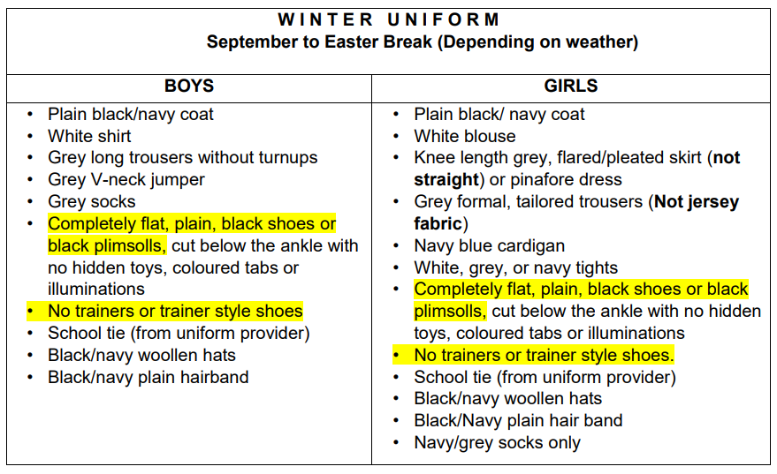
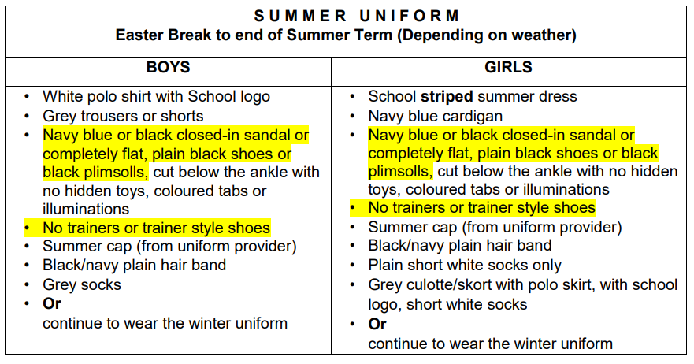
In Reception, the uniform policy can be found on the website under uniform policy.

Slide 9


Food and Drink
Lunch: At lunch time, your child can have a packed lunch prepared at home and brought into school, or a school dinner. All Reception and key stage 1 children are entitled to a free school meal each day. There will be a selection of different meals available each day for your child to choose from. Vegetarian options are always available. Please let us know if your child has any other dietary restrictions or requirements.
Packed lunches should support healthy eating. Please note that our school is a ‘nut free’ zone which means that all types of nuts are banned. Also note that fizzy drinks/sweets/chocolate are not allowed in school lunches.
Snacks: Children will receive a free piece of fruit during the day.
Drinks: Children can bring in a water bottle that is accessible throughout the day. Please fill this bottle with water, no juice or fizzy drinks.

Slide 10

Health
Health: Staff need to be aware of your child’s medical background, in particular any allergies (e.g. bee stings, dairy food), any dietary restrictions (e.g. vegetarian or Halal) and any medical conditions that are important for us to know (e.g. asthma or eczema).
Children can suddenly become ill and therefore it is important that we know we can contact you or another adult relative/friend at all times. It is useful if your emergency contact lives near to school, so it may be more appropriate to choose a friend instead of a family member for us to contact if we cannot reach you.
Please ensure that the school is kept up to date with your contact details. If your child is unable to attend school due to illness, please use Studybugs to let us know.

Slide 11

Helping Your Child to Settle
These are a few ways that you can prepare your child for the first few weeks at school:
Ensure that they can dress and undress themselves.
Help them to master basic cutlery skills.
Think about packaging in lunchboxes, for example, yoghurt tubes can be tricky to open.
Help them to be independent with their toileting skills.
Encourage them to sit and listen to stories.
Help them to develop the confidence to communicate
with new people.
Practise sharing and taking turns.

Slide 12
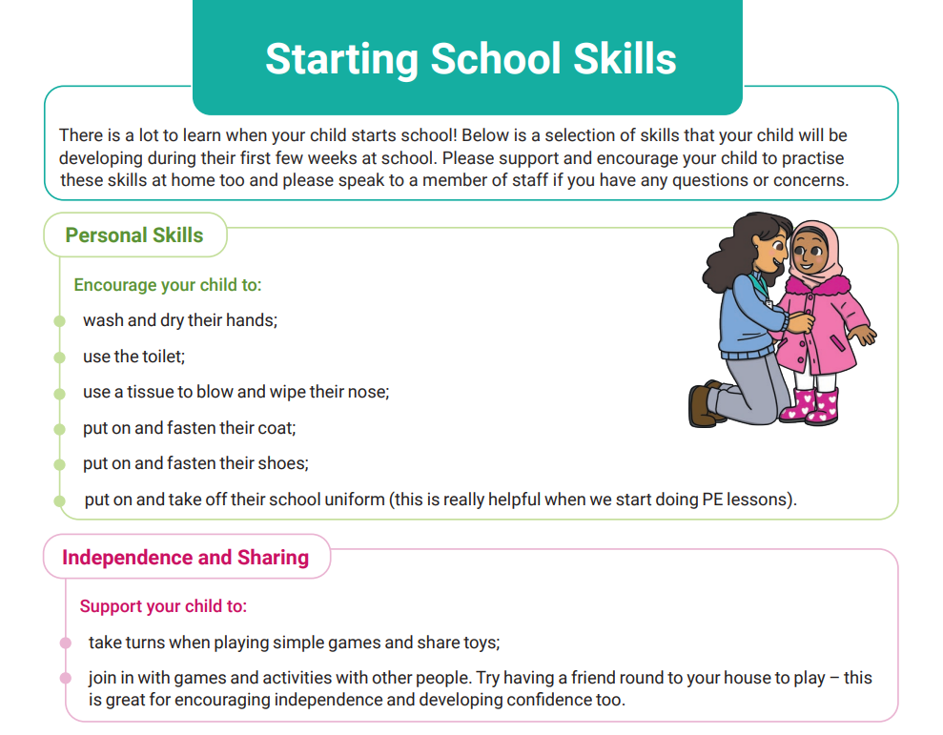
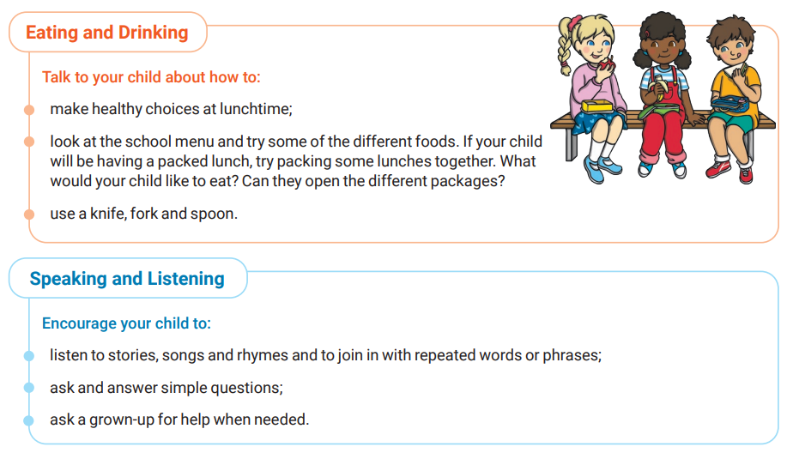
What can you do to help?

Slide 13
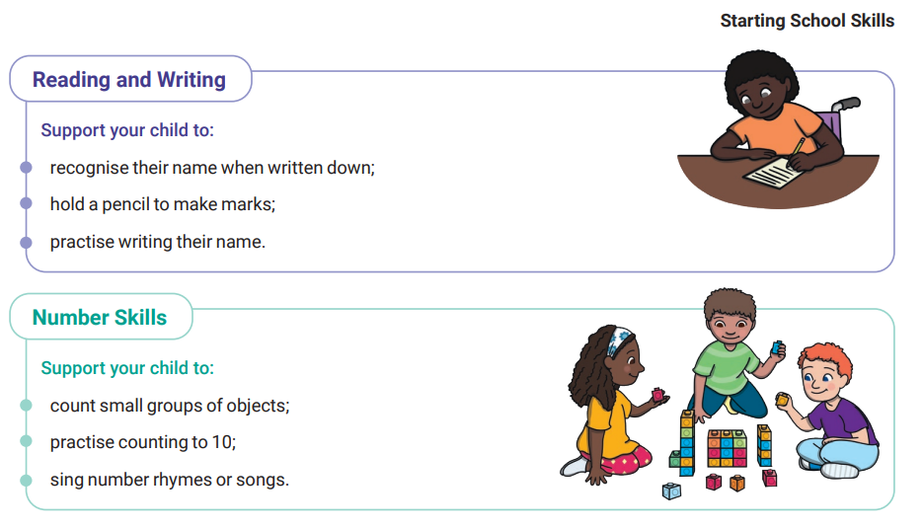
https://www.bbc.co.uk/bitesize/groups/cx1lpm3ve37t https://www.hertfordshire.gov.uk/about-the-council/news/news-archive/is-your-child-school-ready

Slide 14
Special Book
Over the Summer, please create a ‘Special Book’ which shows your child’s interests, family information and anything your child wants to tell us. Contents you may want to include are photos of family members and pets, information about favourite toys, favourite books and activities that your child likes to take part in. ​
​
The Special Book can be in the form of a photo book, scrap book or a notebook. This will be continually available for your child to access within class. It is an important tool to encourage your child to share about themselves with staff, but more importantly, with their new friends.

Slide 15

There will be a PowerPoint on our school website for you to look at with your child over the summer holidays. This will have photos of the classrooms and outside area so that your child can become familiar with their new environment.
We hope that this presentation is useful. Should you have any questions, please feel free to speak to a member of staff.
We aim to ensure that your children’s experience in Nursery and Reception is a happy and rewarding one. We look forward to working with both you and your children.

