Slide 1



Slide 2
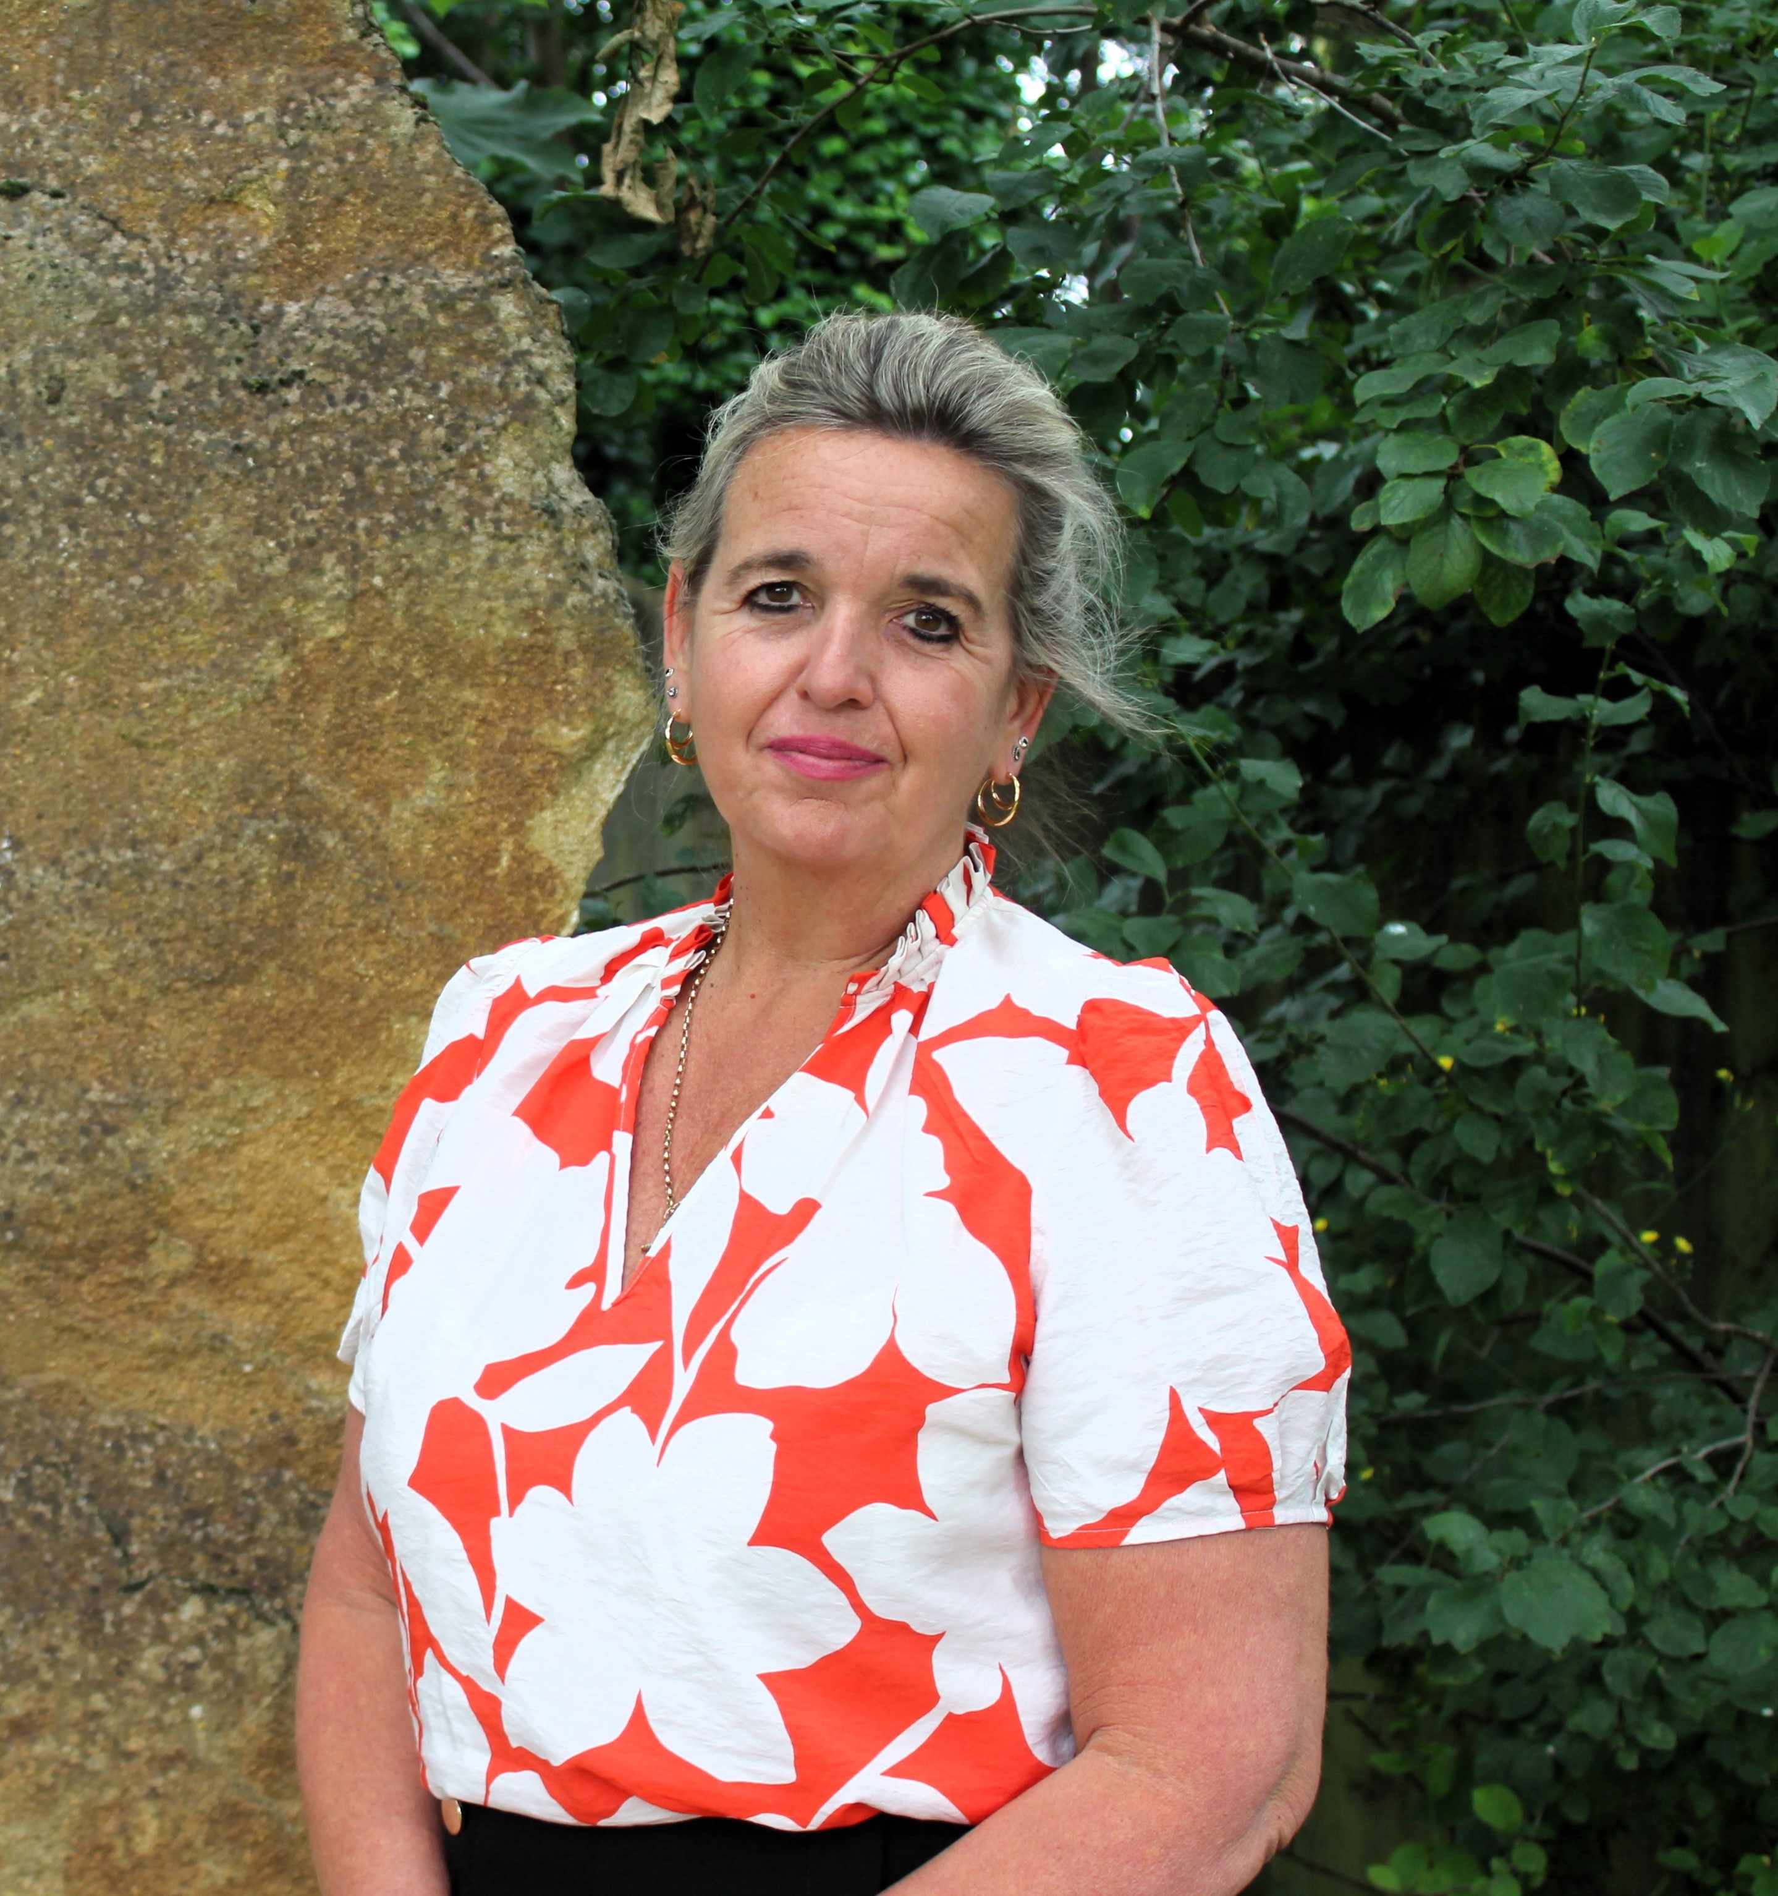
Mrs Joanne Walsh – Executive Headteacher

Slide 3
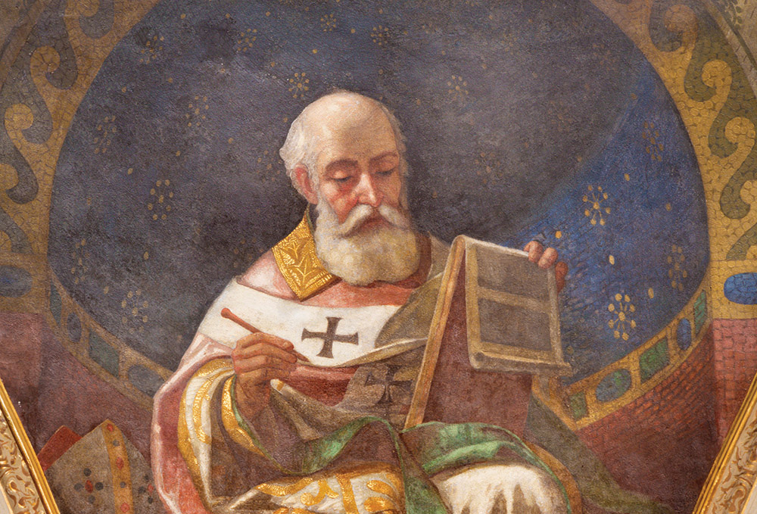
St. Augustine of Hippo viewed education as a crucial path to both intellectual and spiritual growth, emphasizing its role in leading individuals towards God and a virtuous life. He believed education should nurture a love of learning, cultivate good habits, and foster a deeper understanding of God and oneself.

Slide 4
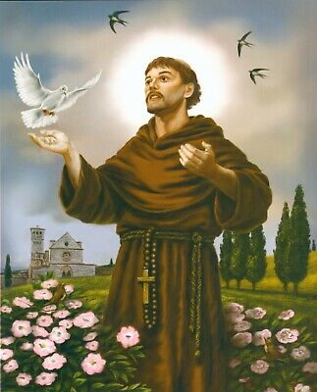
https://www.stfrancistrust.net/
Inspired by the teachings of Christ and the example of St Francis, we strive for excellence, cherishing every child in our care as a unique thumbprint of God, enabling all to realise their full potential.

Slide 5

Be a pilgrim with us in the Church Year of Jubilee
In a world that is growing more unjust and unequal, we invite people, schools and communities to experience the joy and strength in coming together as we respond to God’s call for a reset, a renewal of faith and a recommitment to a just world.

Slide 6
Leadership Team
Deputy Headteacher –Mrs. Faulkner
Assistant Headteacher–Mrs. Baldwin
EYFS and Key Stage 1 Leader – Mrs. Blackwell

Slide 7
EYFS Staff Team
Reception Class
– Mrs. Blackwell, Teacher
Mrs Amadeo
Nursery Class
Mrs Smitham, Teacher
Mrs. Pugsley, LSA
- Mrs Ranasinghe, LSA

Slide 8
Vision Statement:
“We come to school to live and learn happily together by loving ourselves and each other as Jesus teaches us”
Golden Rule:
Treat others the way you want to be treated
Church School –Building Fund - Arbor

Slide 9
Stakeholders (work in partnership)
Academy Trust
Local Governors
Staff
Parents
Children

Slide 10
Communication (seamless transition from local pre-schools; school website; parentemail;; newsletters; parent workshops; Home/School Learning Partnership)
Social Media
Home School Agreement
Parent/Visitors Conduct Agreement
SAPTA
Parent Forum
Curriculum Overview/ Signposts weekly

