Slide 1


St Augustine’s Catholic Primary School
We come to school to live and learn happily together
by loving ourselves and each other as Jesus teaches us.

Slide 2
A Day In The Life of
Reception…

Slide 3
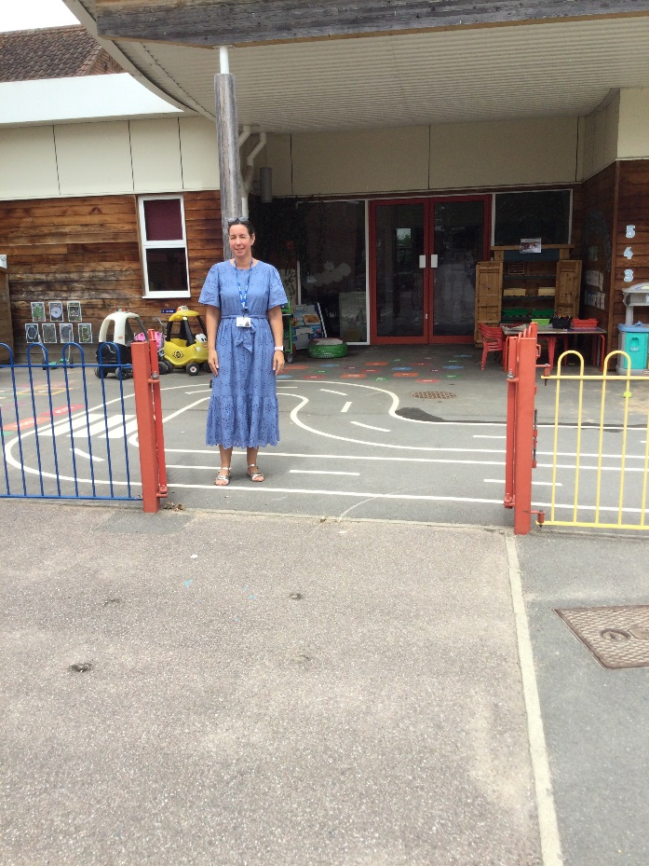
In the morning, come through the main gate and walk down to the EYFS gate where Mrs Blackwell will be waiting to welcome you. Gates are open between 8:40am and 8:50am.

Slide 4
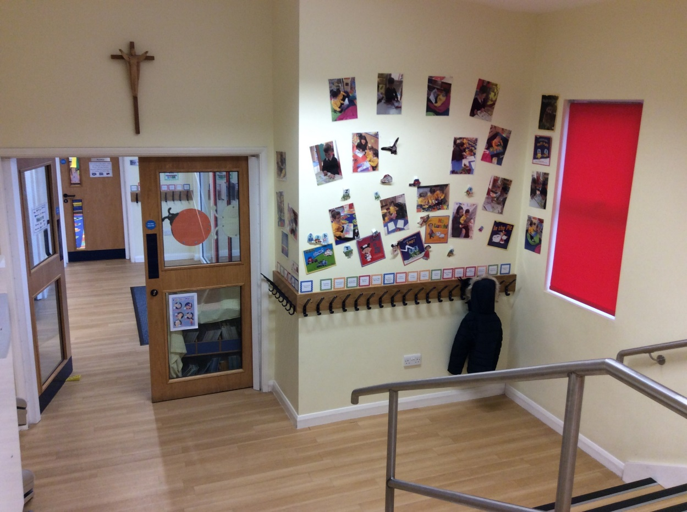
In the cloakroom they will find their named peg.

Slide 5
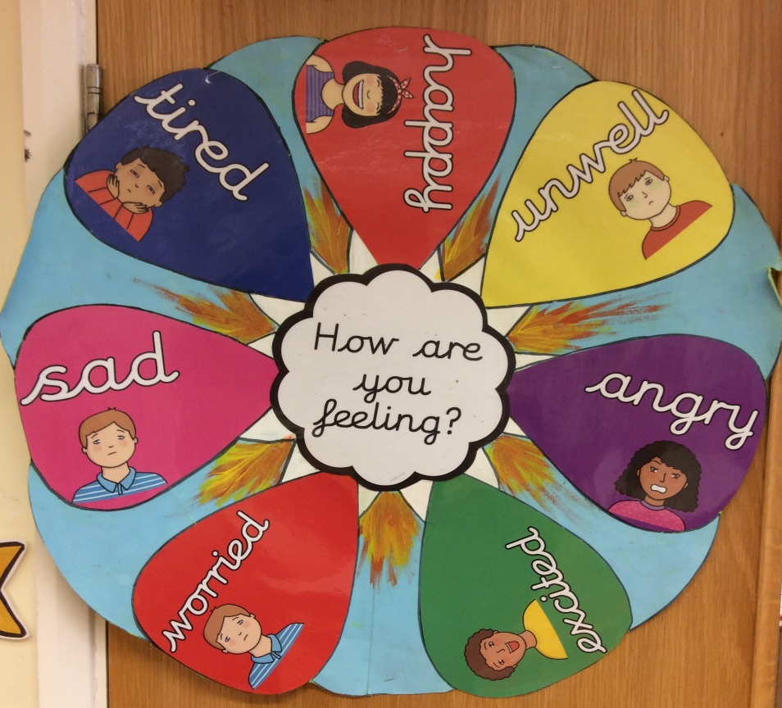
Children self-register by finding their name card and placing it on the ‘emotions chart’.

Slide 6
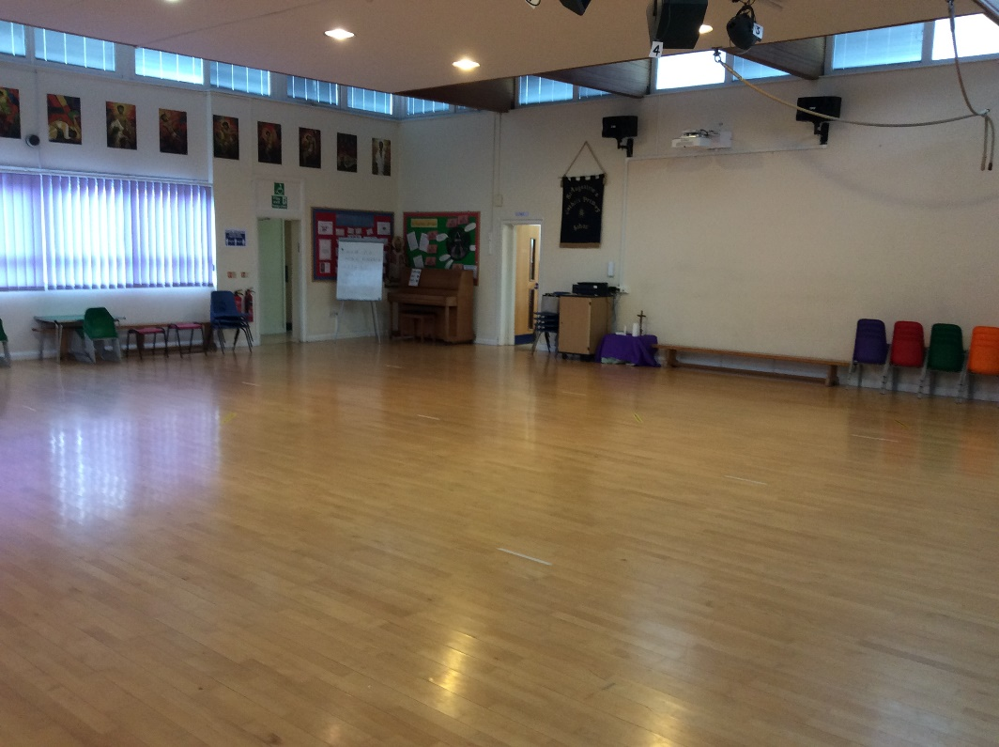
Our school day usually begins with a whole school
assembly in the school hall.

Slide 7
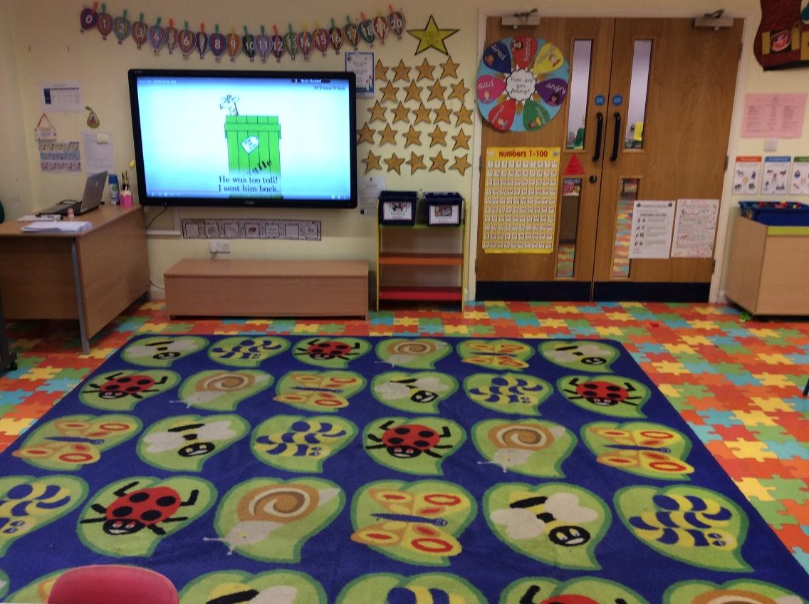
Whole class teaching takes part on the carpet before children complete their focus activities.
In the morning, we start with Literacy lessons.

Slide 8
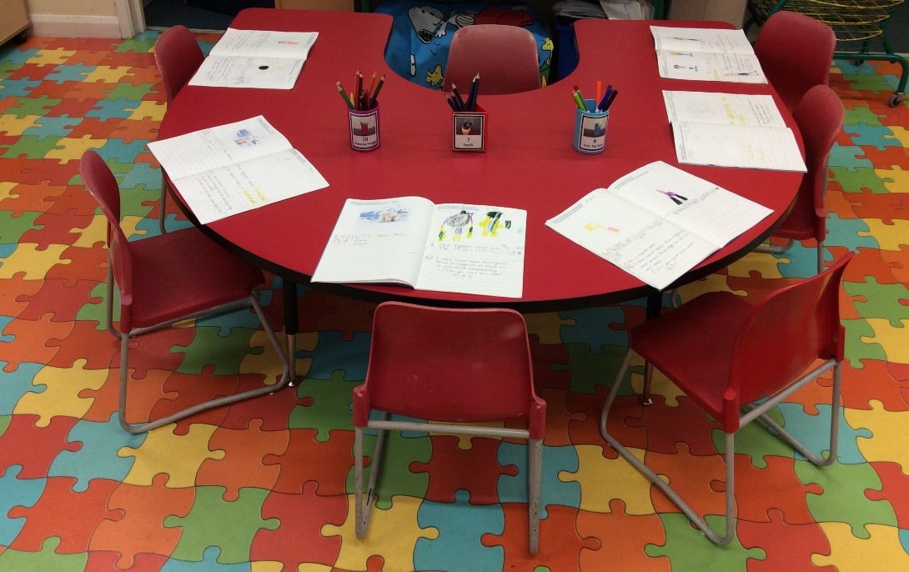
A focus activity takes place daily which is rotated between the groups throughout the week. This activity links to the Literacy whole class teaching that has taken place on the carpet and independent activities link to all areas of learning.

Slide 9
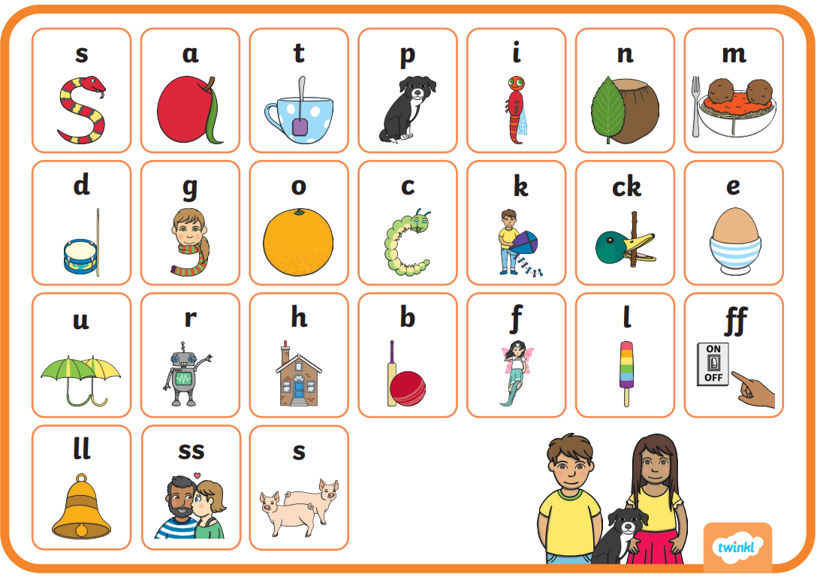
Phonics lessons take place daily. We follow Twinkl Phonics.

Slide 10
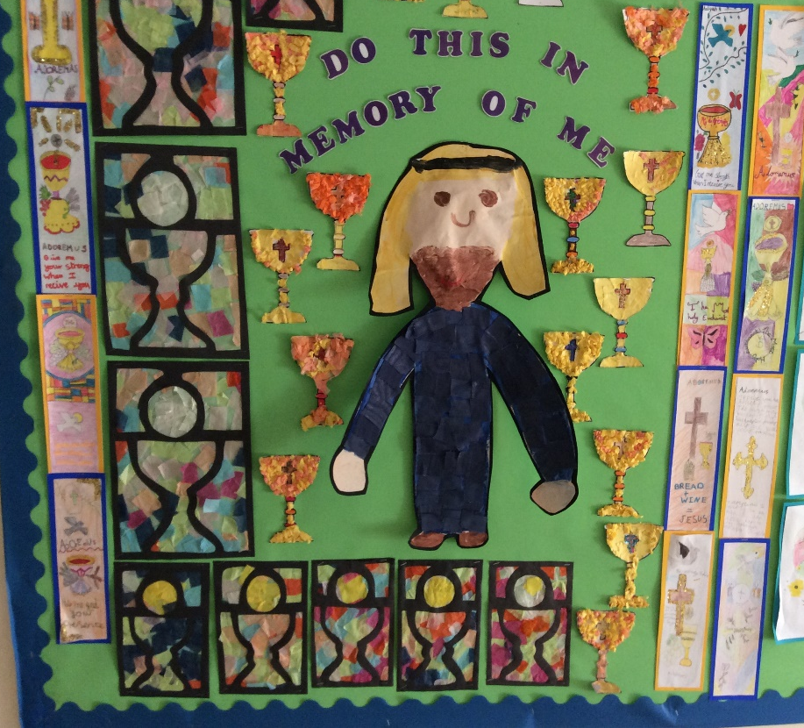
Children take part in RE lessons and complete an RE focus activity which is rotated between groups throughout the week.

Slide 11
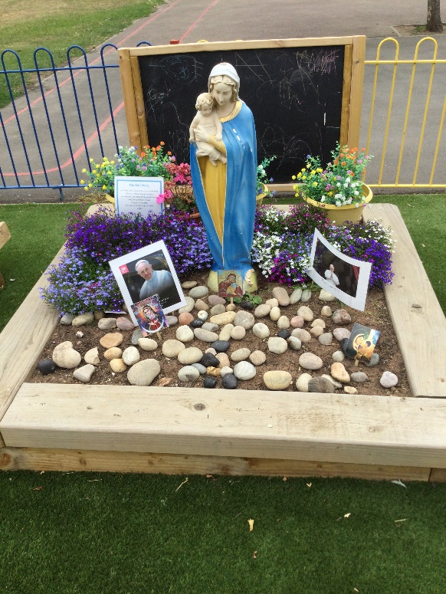
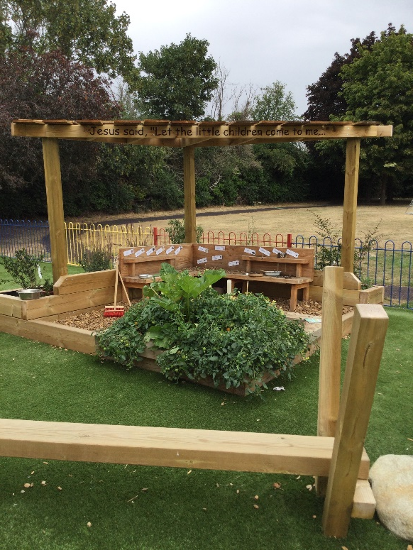
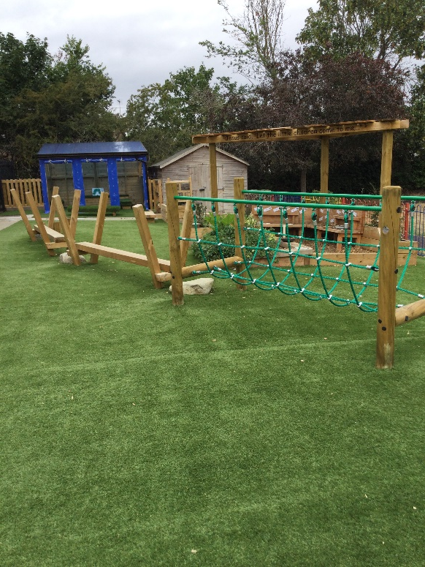
Children have the opportunity to apply their learning in their own play during Child Initiated learning both inside and outside of the classroom. During this time, we also operate rolling snack.

Slide 12
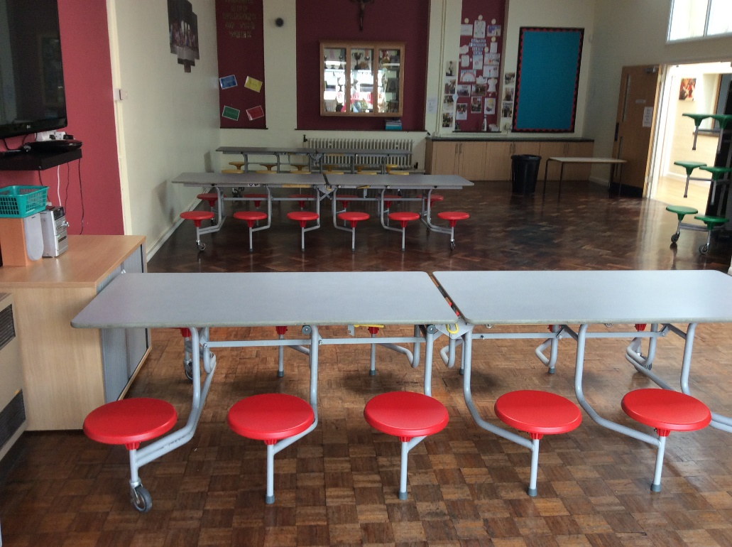
After Child Initiated Learning it is time to get ready for lunch. Children wash their hands and line up ready to go to the dining hall to eat their lunch.

Slide 13

After children have eaten their lunch, they go out to play.

Slide 14
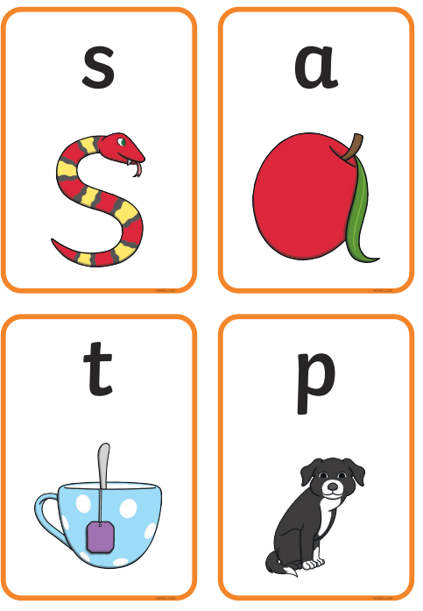
The second Phonics lesson takes place as a whole class
after lunch and this lasts for 10 minutes.

Slide 15
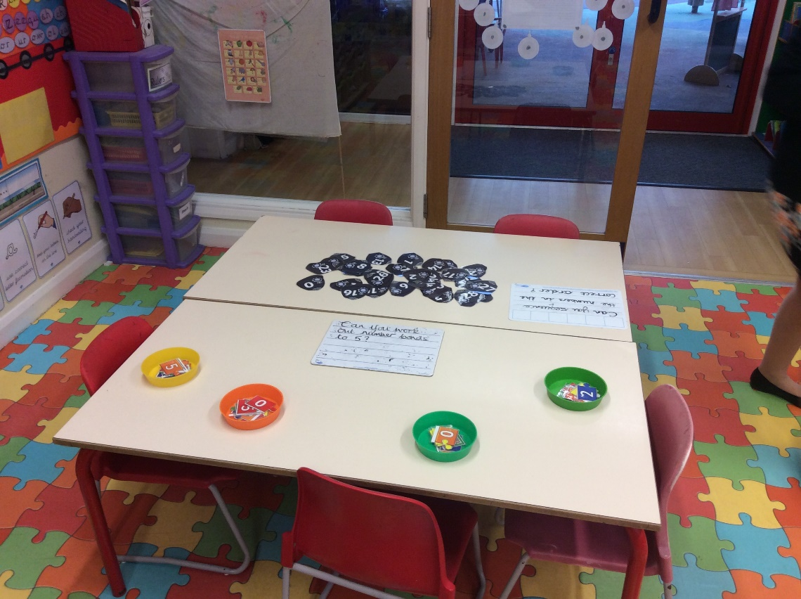
Whole class Maths teaching takes place on the carpet. The Maths Adult Led activity is rotated between groups throughout the week. Independent activities link to all areas of learning.

Slide 16
After the Adult Led activities have taken place, children again have the opportunity to apply their learning in their own play during Child Initiated learning both inside and outside of the classroom.

Slide 17

Once children have collected their belongings ready for home time, they find their carpet space and listen to a story.

Slide 18
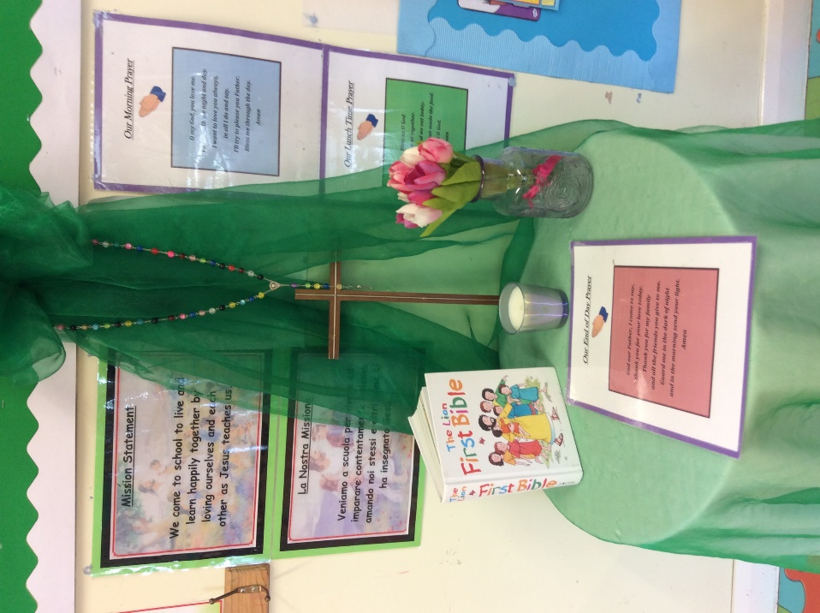
Finally, children say their end of day prayer before being collected at the end of the day.

Slide 19
At the end of the day, come through the main gate and walk down to EYFS gate where Mrs Blackwell will be waiting to send your child home.

