Slide 1


St Augustine’s Catholic Primary School
We come to school to live and learn happily together
by loving ourselves and each other as Jesus teaches us.

Slide 2
A Day In The Life of
Nursery…

Slide 3
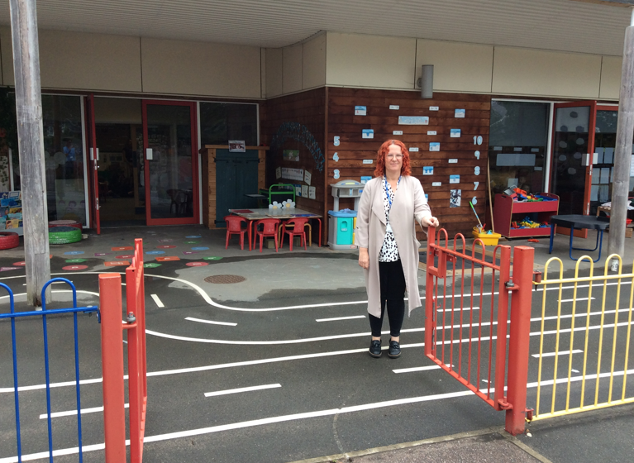
In the morning, come through the main gate and walk down to EYFS gate where Mrs Smitham will be waiting to welcome you. Gates are open between 8:40 and 8:50am.
.

Slide 4
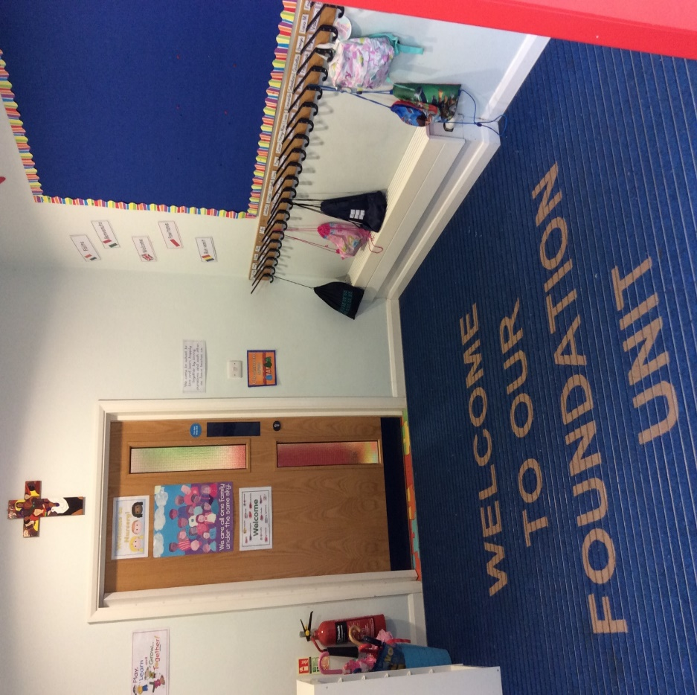
In the cloakroom, they will find their named peg.

Slide 5
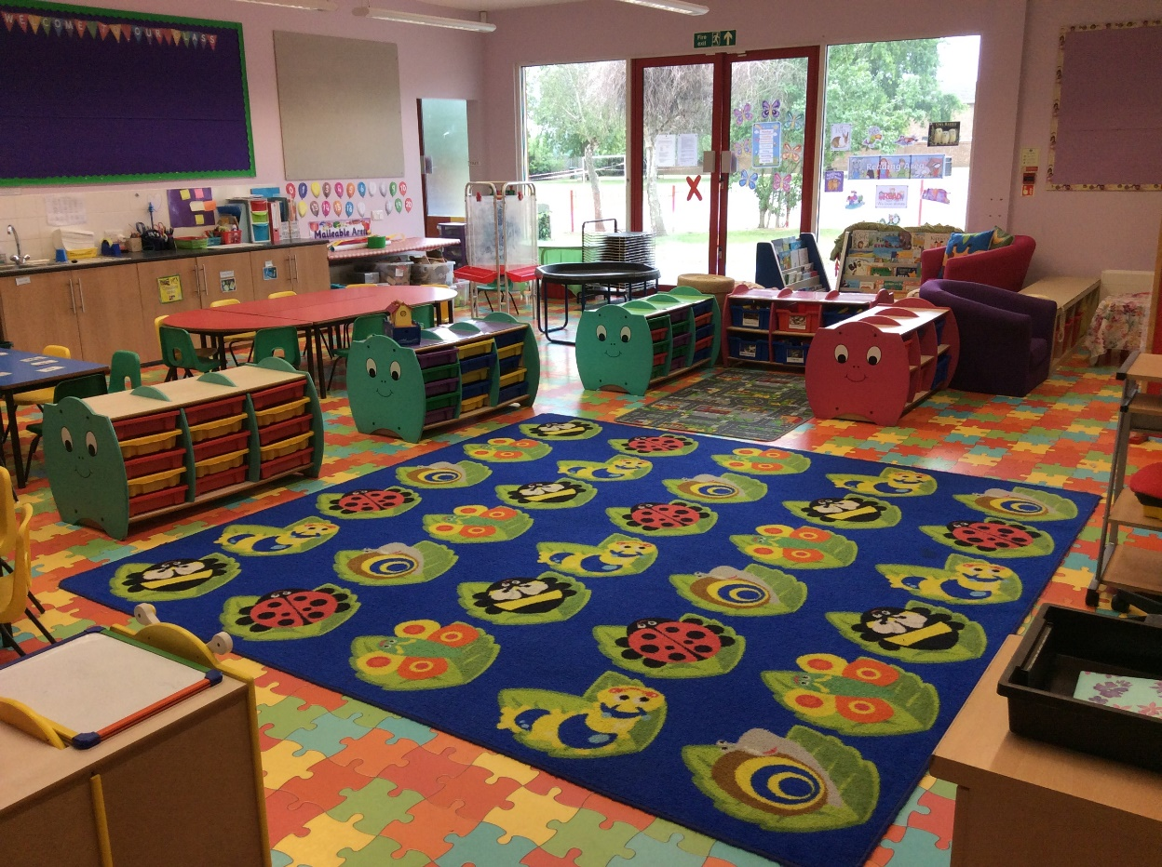
Once children have hung up their coats and bags, they will be welcomed into our Nursery classroom.

Slide 6
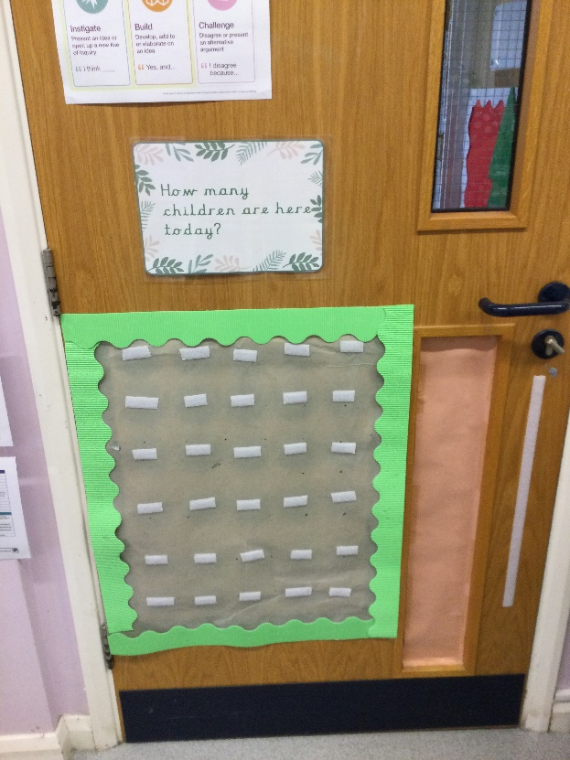
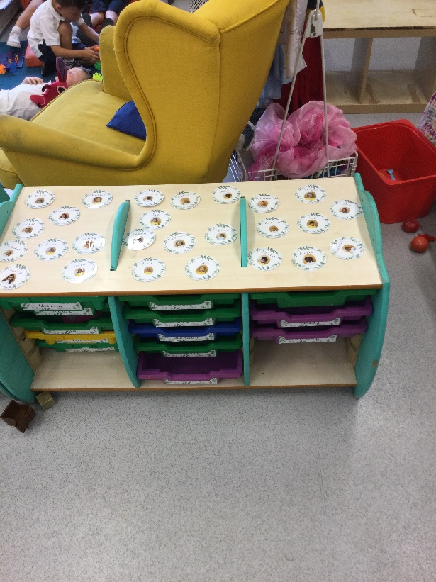
Children self-register by finding their name card and as their writing skills develop, they move on to writing their name.

Slide 7
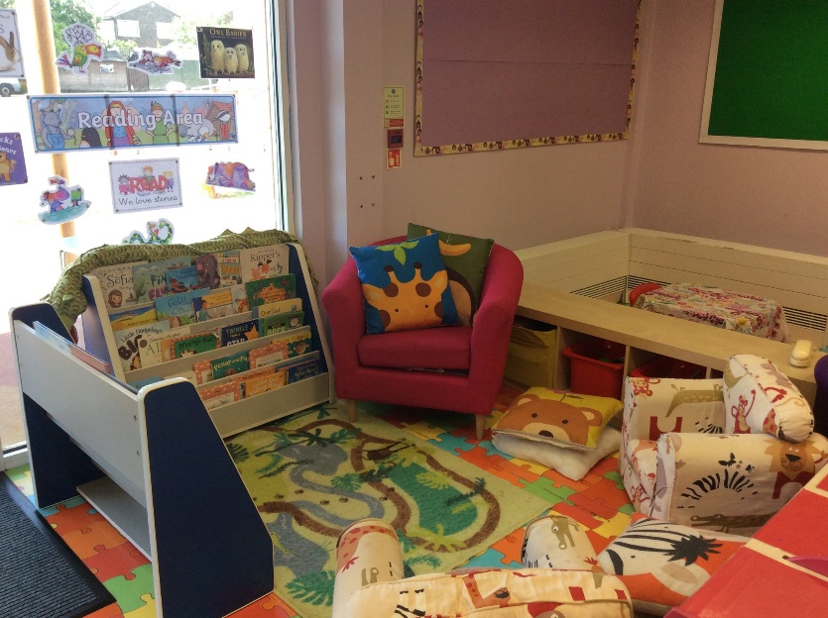
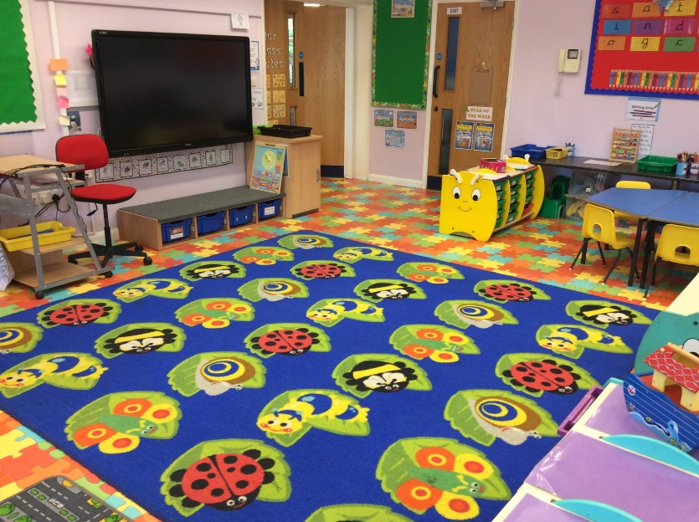
Children sit in small groups to take part in a short session that includes Level 1 phonics, number, shape and colour recognition.

Slide 8

Whole class teaching takes part on the carpet with a particular focus each day. Teaching sessions include
Literacy, Maths, RE, PSED and UW.

Slide 9
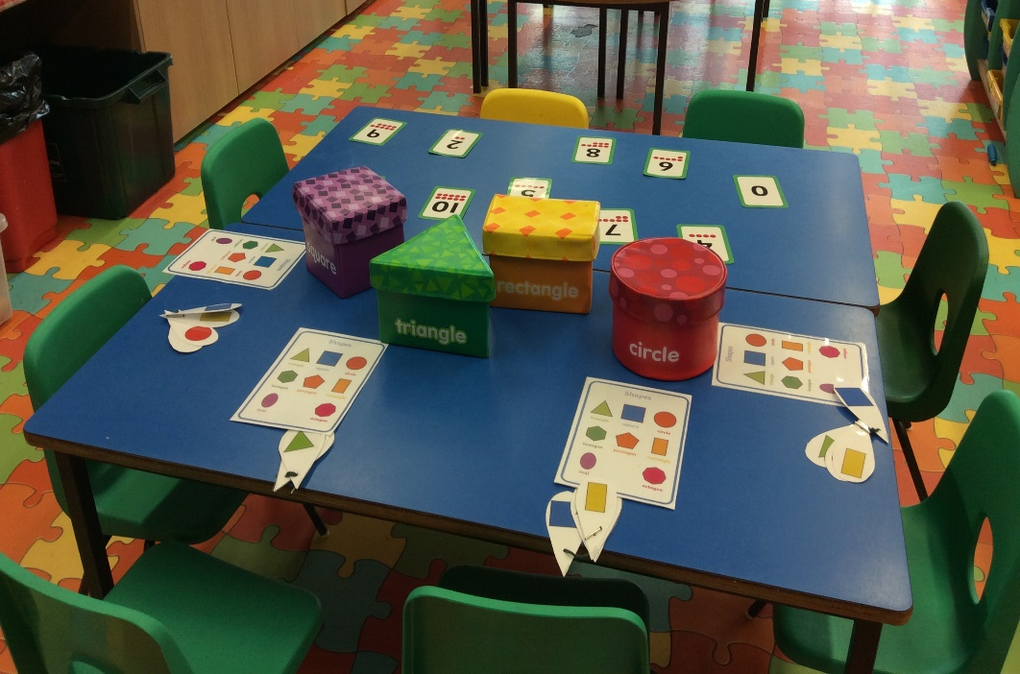
An Adult Led activity takes place daily and all children participate throughout the week. The activity links to the whole class teaching that has taken place on the carpet.

Slide 10
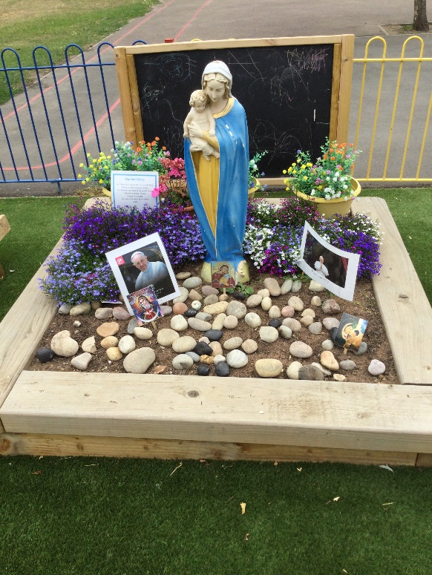
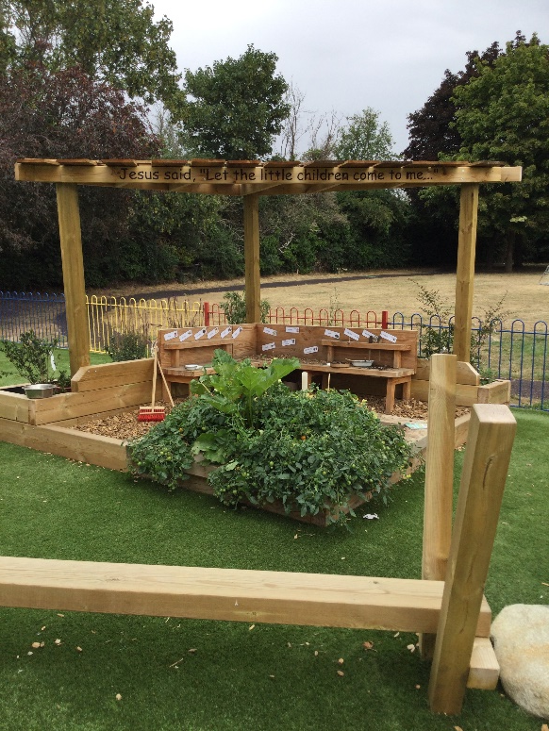
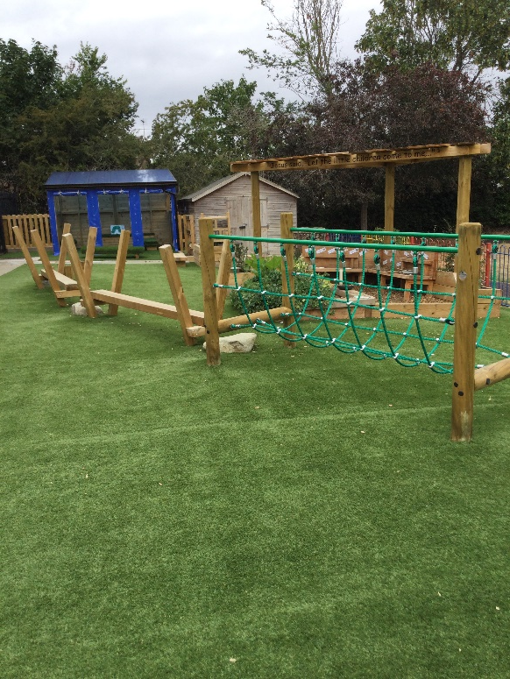
Children have the opportunity to apply their learning in their own play during Child Initiated learning both inside and outside of the classroom. During this time, we also operate rolling snack.

Slide 11

Children take part in early Literacy activities daily.

Slide 12
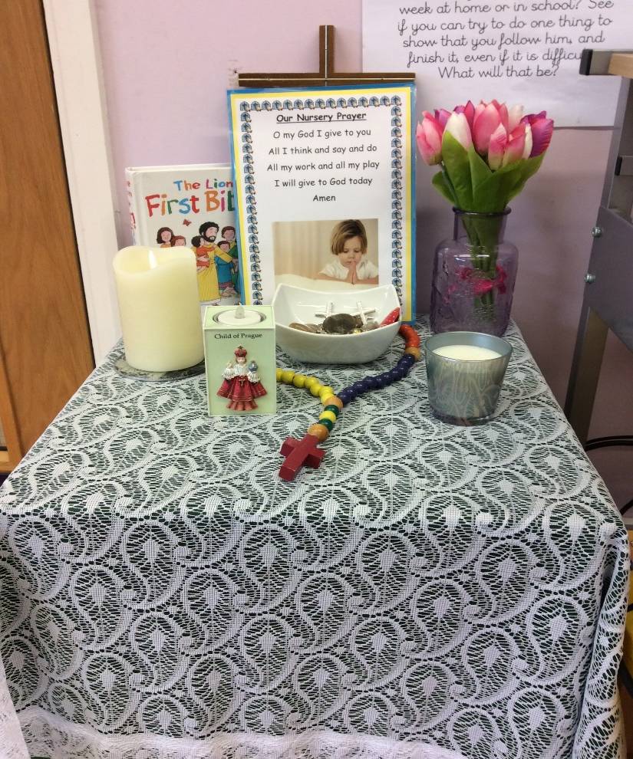
Finally, children say their end of session prayer together
before being collected.

Slide 13
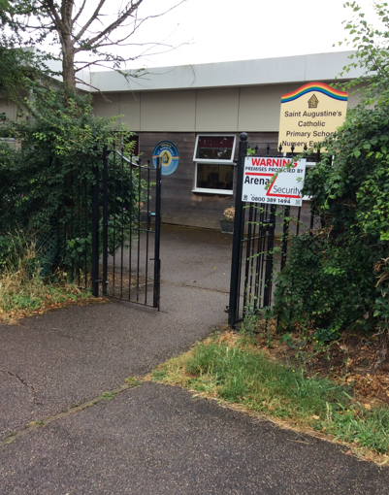
Pick up will be from the side entrance between 11:30-11:40am for morning children and 2:30-2:40pm for afternoon children.

